Slide 1
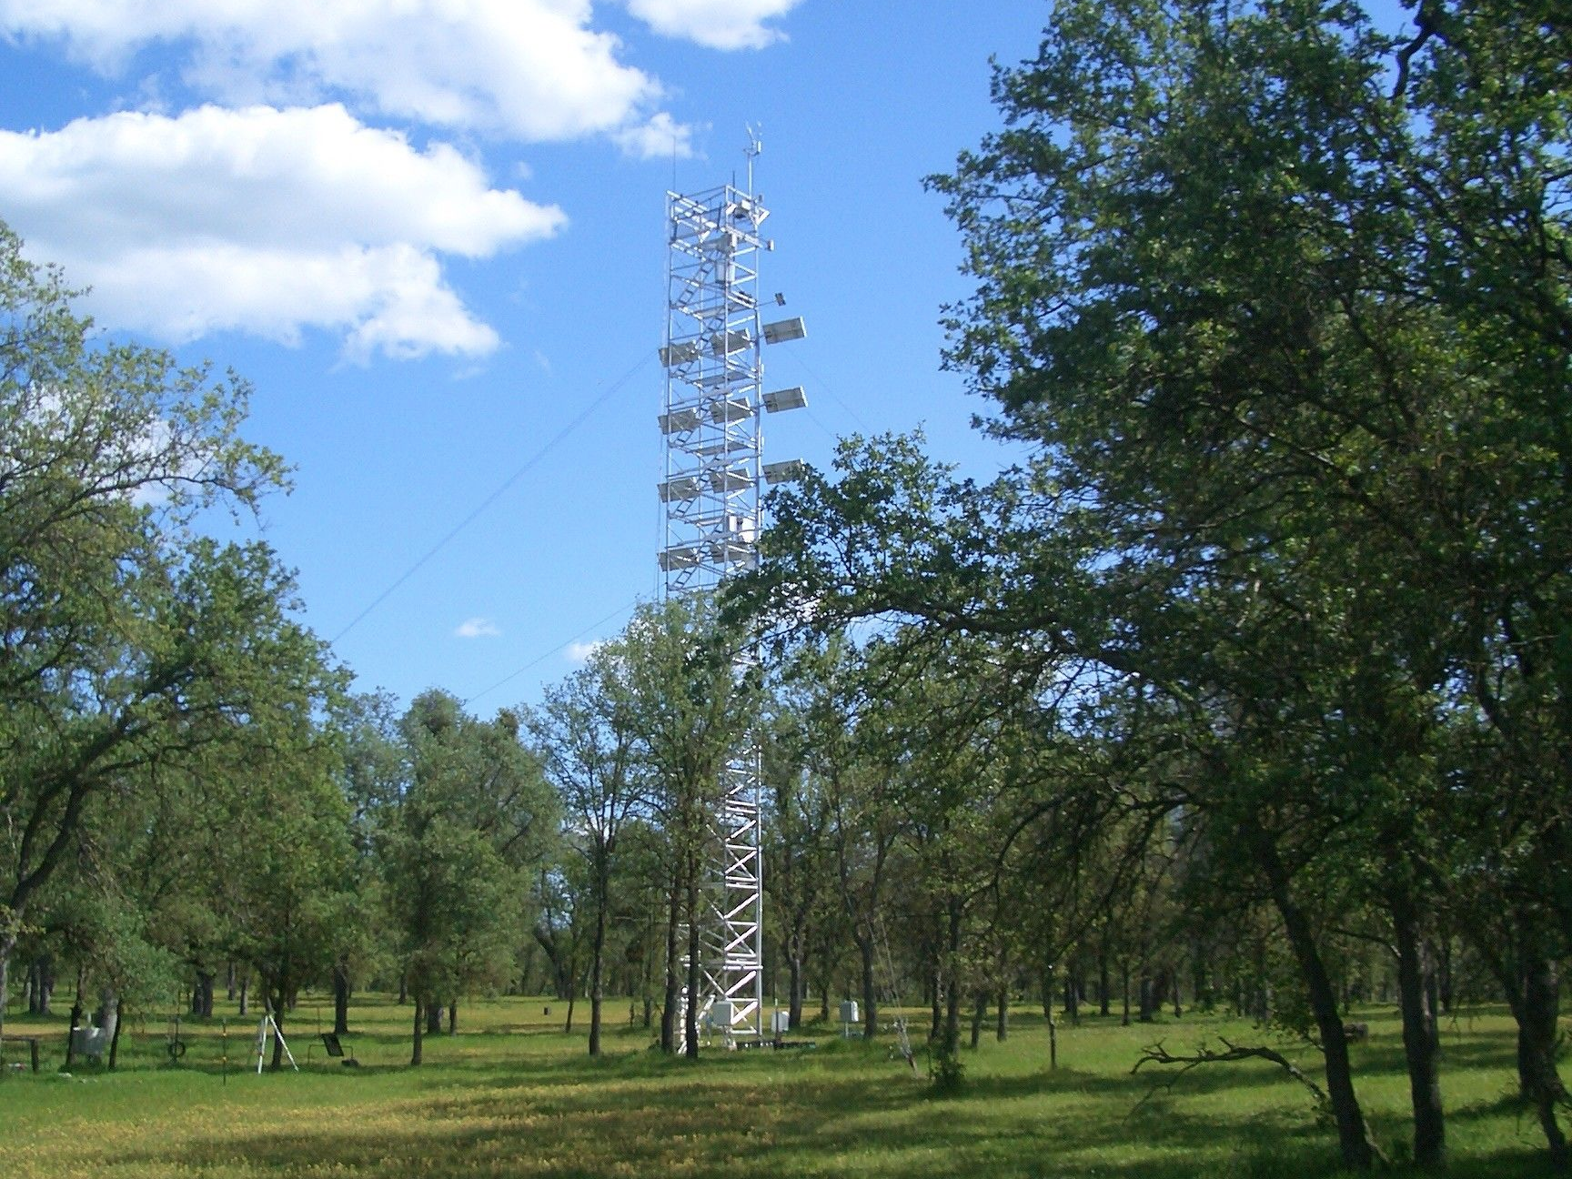


EVALUATION OF NASA’S CARBON MONITORING SYSTEM FLUX PILOT: TERRESTRIAL CO₂ FLUXES
JOSHUA B. FISHER
AARON POLHAMUS, KEVIN BOWMAN, JUNJIE LIU, MEEMONG LEE, MARTIN JUNG, MARKUS REICHSTEIN, JIM COLLATZ, CHRIS POTTER,
THE REST OF THE CMS FLUX TEAM
National Aeronautics and Space Administration
National Aeronautics and Space Administration
Jet Propulsion Laboratory
California Institute of Technology
Pasadena, California
www.nasa.gov

Slide 2
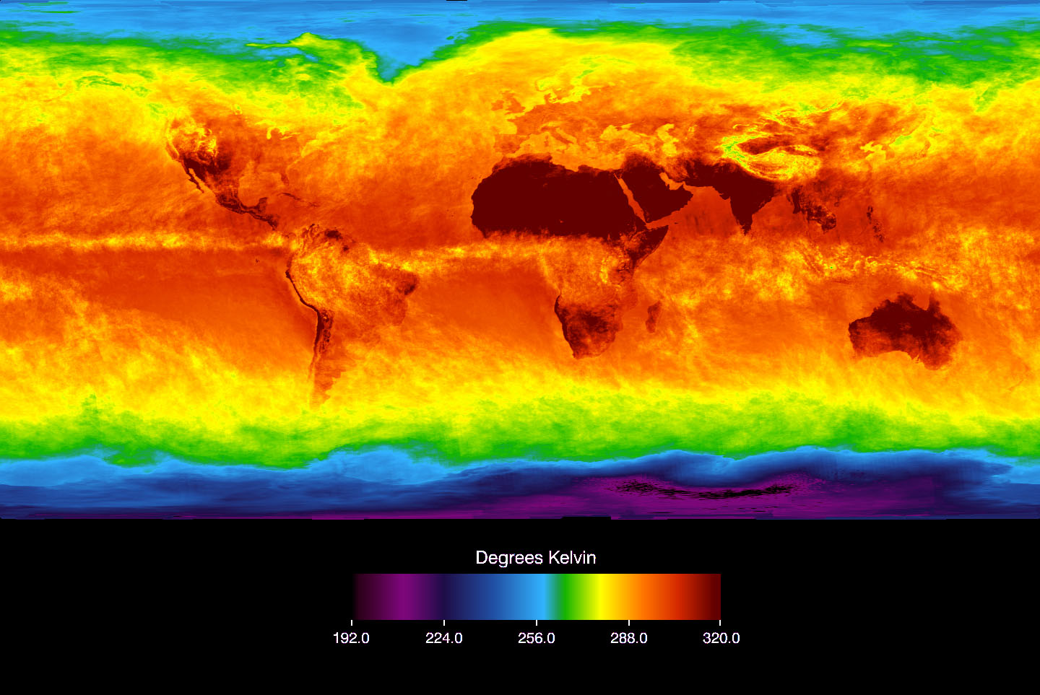
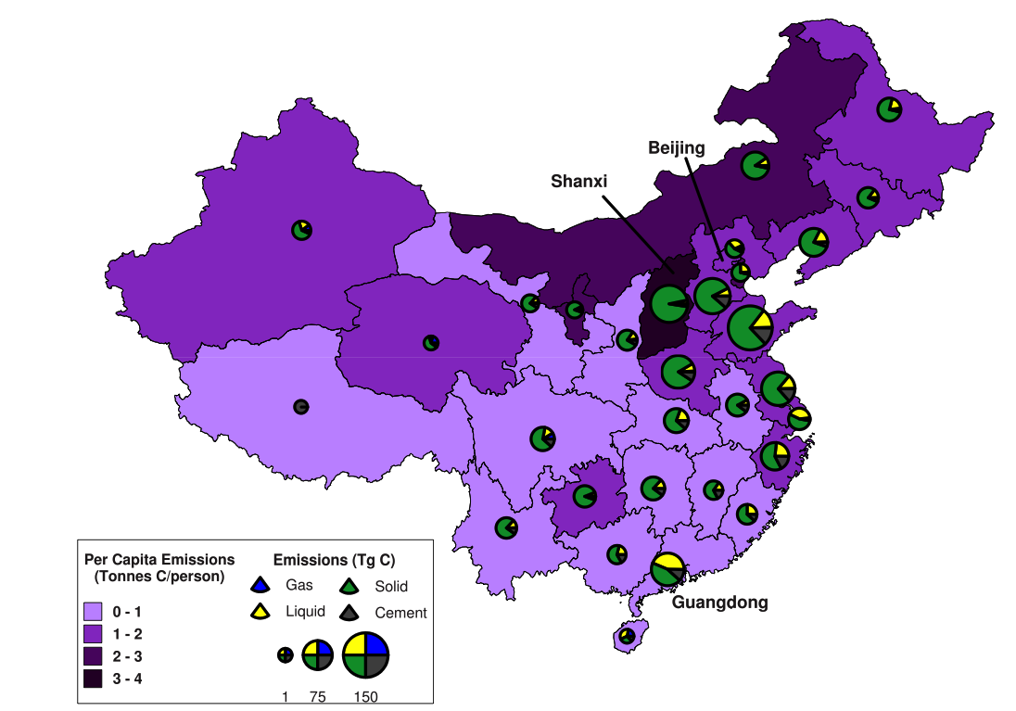
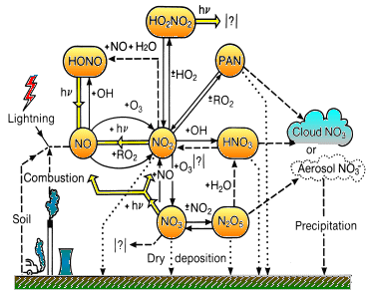
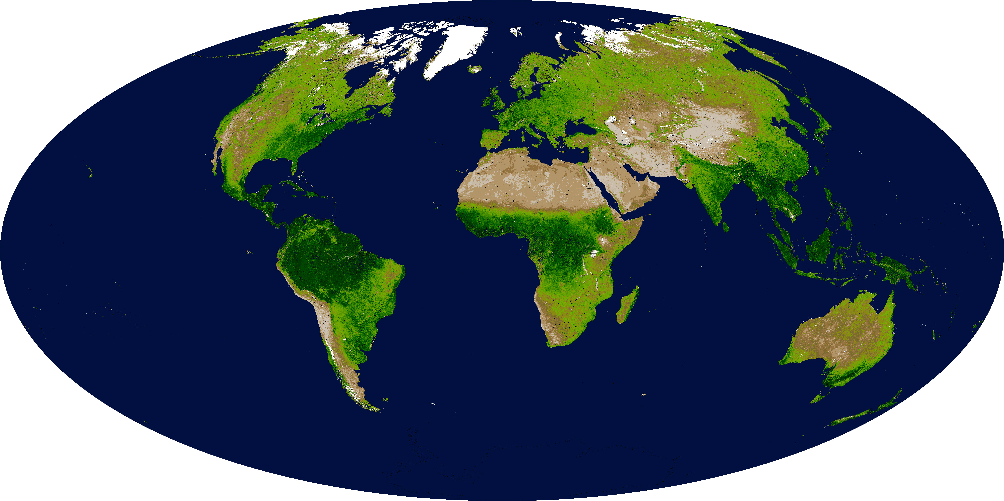
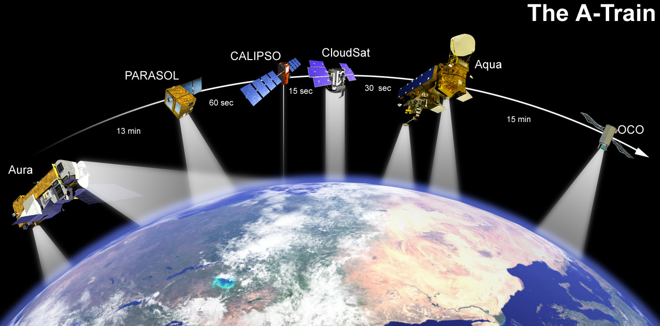
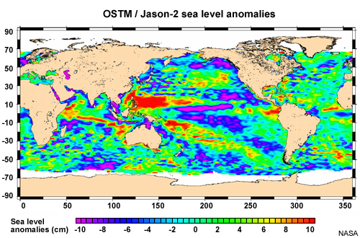
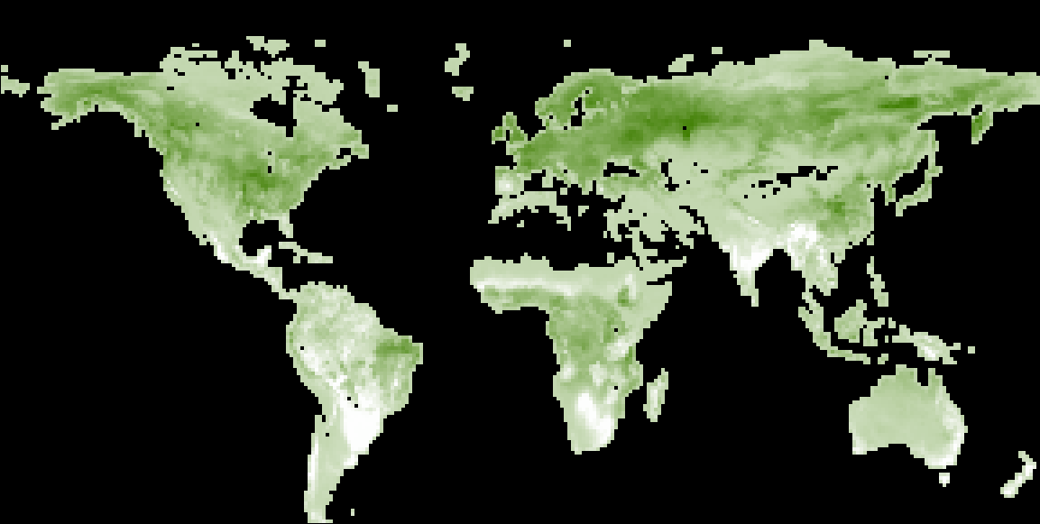
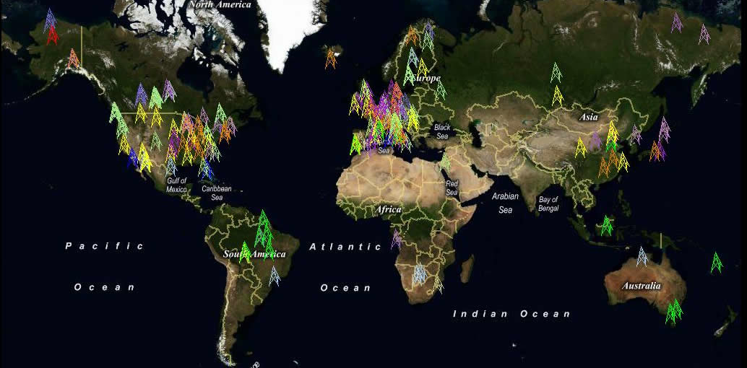
NASA CMS FLUX SYSTEM
NASA satellites
NASA models/
assimilation
NASA inverse
modeling
Inverse
GEOS-Chem
Atmos
GEOS-5
Anthropogenic
winds
(u,v)
T, q, p,.. (AIRS)
FF, land-use,
chemical production
Terrestrial
CASA/
CASA-GFED
EVI, FPAR,.. (MODIS)
NEE
Satellite CO2 sensors
(GOSAT, TES, AIRS)
Ocean
NOBM/
JPL-MIT ECCO2
Optimal flux (gC/m²/day)
Independent tests
(FLUXNET,)
chlorophyll, altimetry,
… (MODIS, JASON)
Air/sea CO2
exchange
Notes:
GEOS-Chem has a rich history of use in understanding atmospheric composition and the inference of surface fluxes.

Slide 3

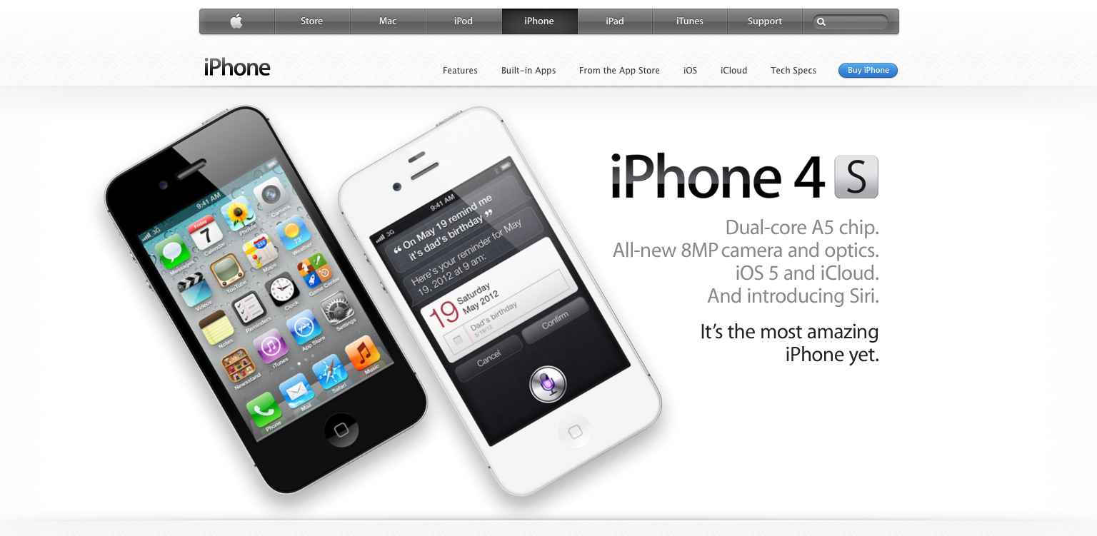
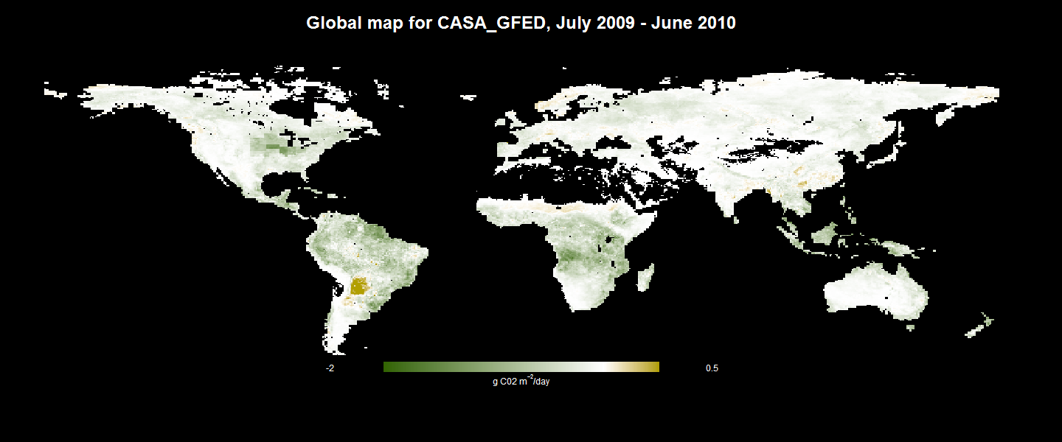
 | Land | Ocean | Atmos | Inverse | Flux | Biomass
CMSFlux
Features | Monthly Maps | Annual Means | Satellite Observations | Models
Download Now
CMSFlux…..
JPL–Goddard–Ames.
GOSAT atmospheric CO₂.
Land-Atmosphere-Ocean models
…and data.
Built in 1 year.
(It’s a product).

Slide 4
IS THE PRODUCT ANY GOOD?

Slide 5
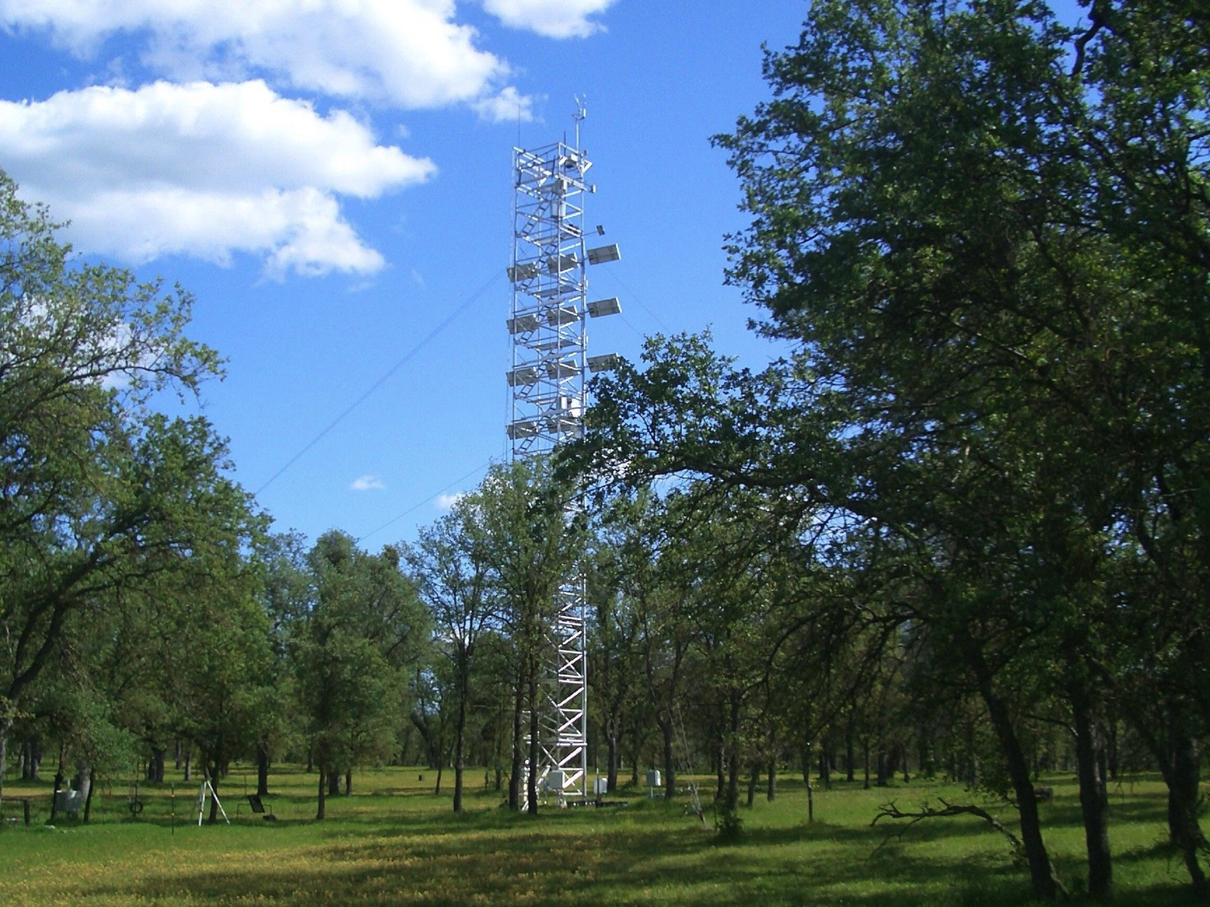
Eddy Covariance
CO₂ w
F_{CO2} = w’ CO₂’
CO₂ Flux = time avg. covariance of vertical wind and CO₂ concentration

Slide 6
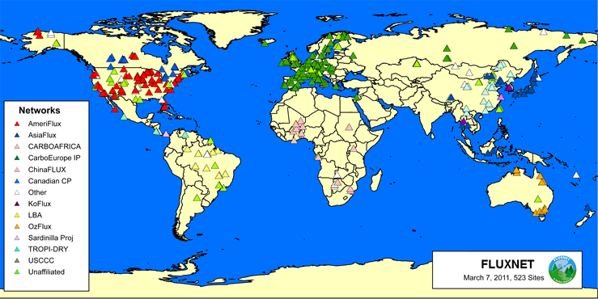
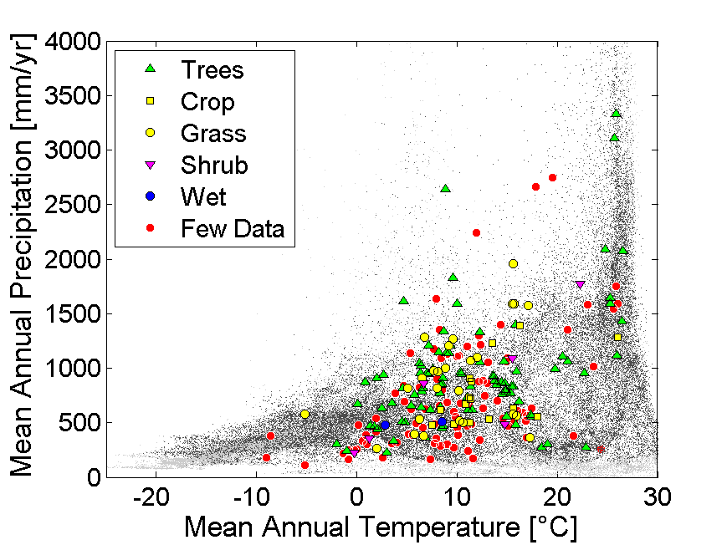
FLUXNET

Slide 7
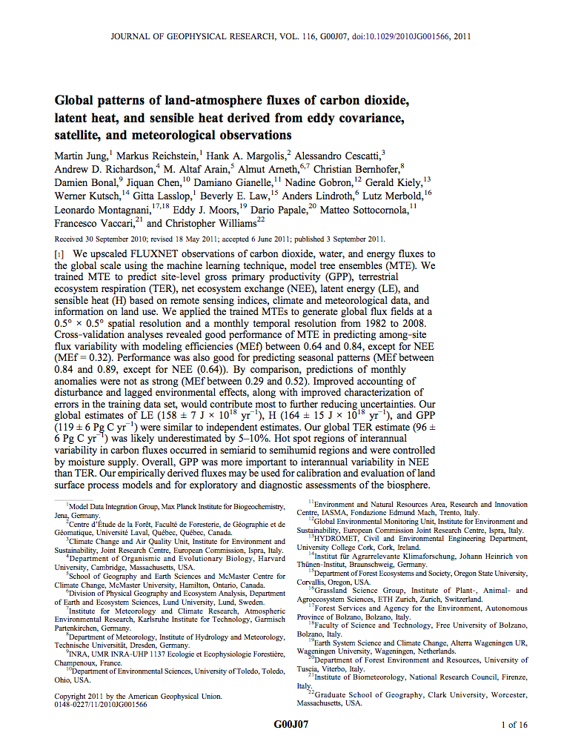
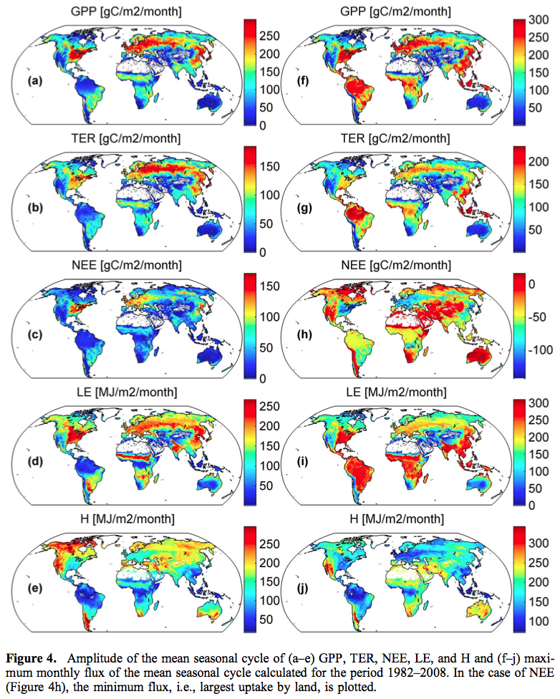
MPI-BGC: empirical/statistical relationships relating measured NEE with meteorology, vegetation type and fAPAR (29 explanatory variables) using 253 sites
EC-MOD: similar technique by Jingfeng Xiao (CMS SDT)

Slide 8

MPI-BGC: HOW TO USE
MPI-BGC
Hotspots
Seasonal variation
Spatial distribution
Interannual variability
Timing of max/min uptake
Amplitude of max – min uptake
DO NOT COMPARE MEAN ANNUAL FLUX
  Disturbance/management history not well-represented in flux sites and statistical model (e.g., lag effects) that are important in global NEE → “Respiration” is low
  Site representation—tropics, savannas

Slide 9
IS THE PRODUCT ANY GOOD EVERYWHERE AND ALL THE TIME?

Slide 10
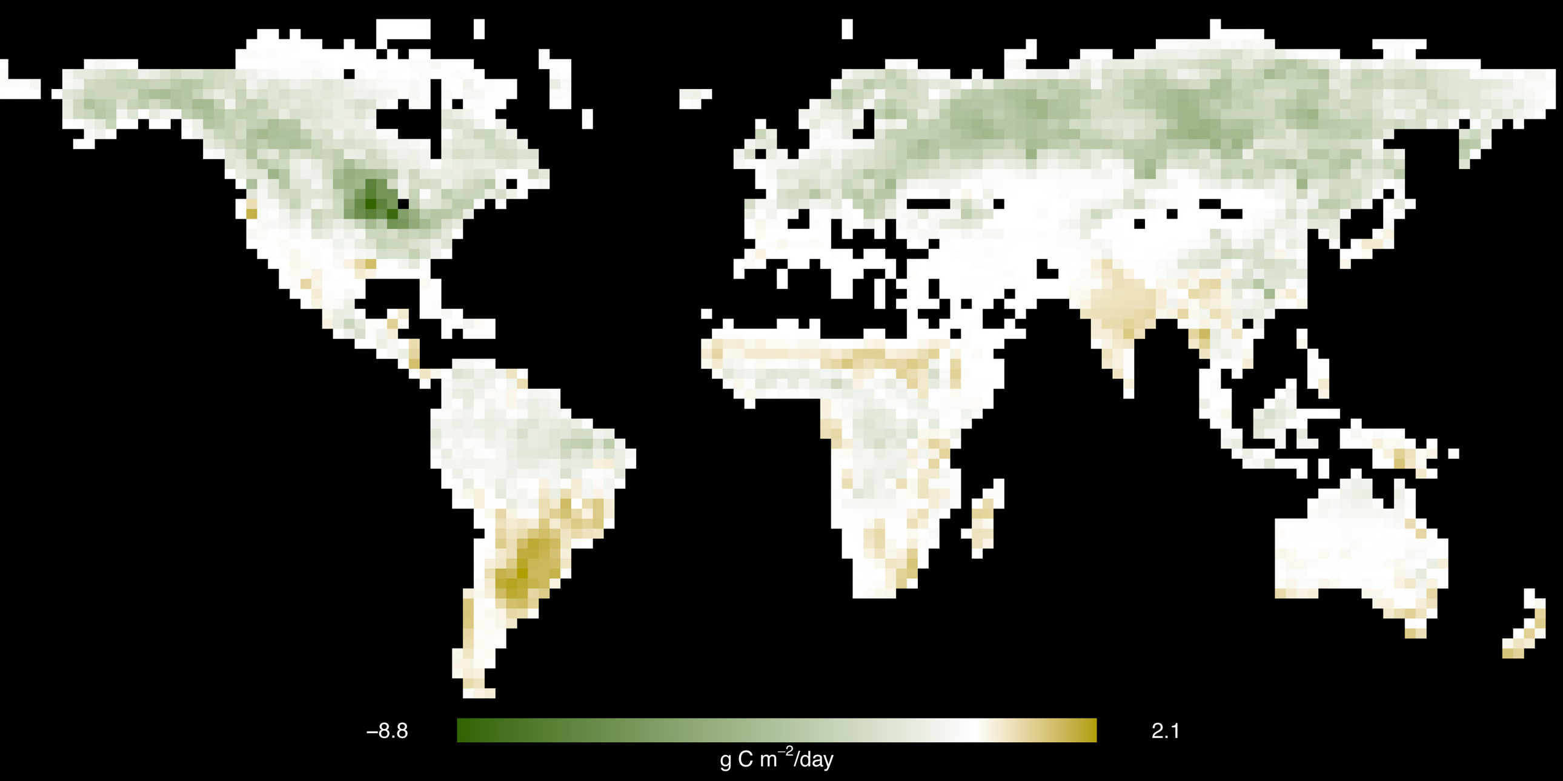
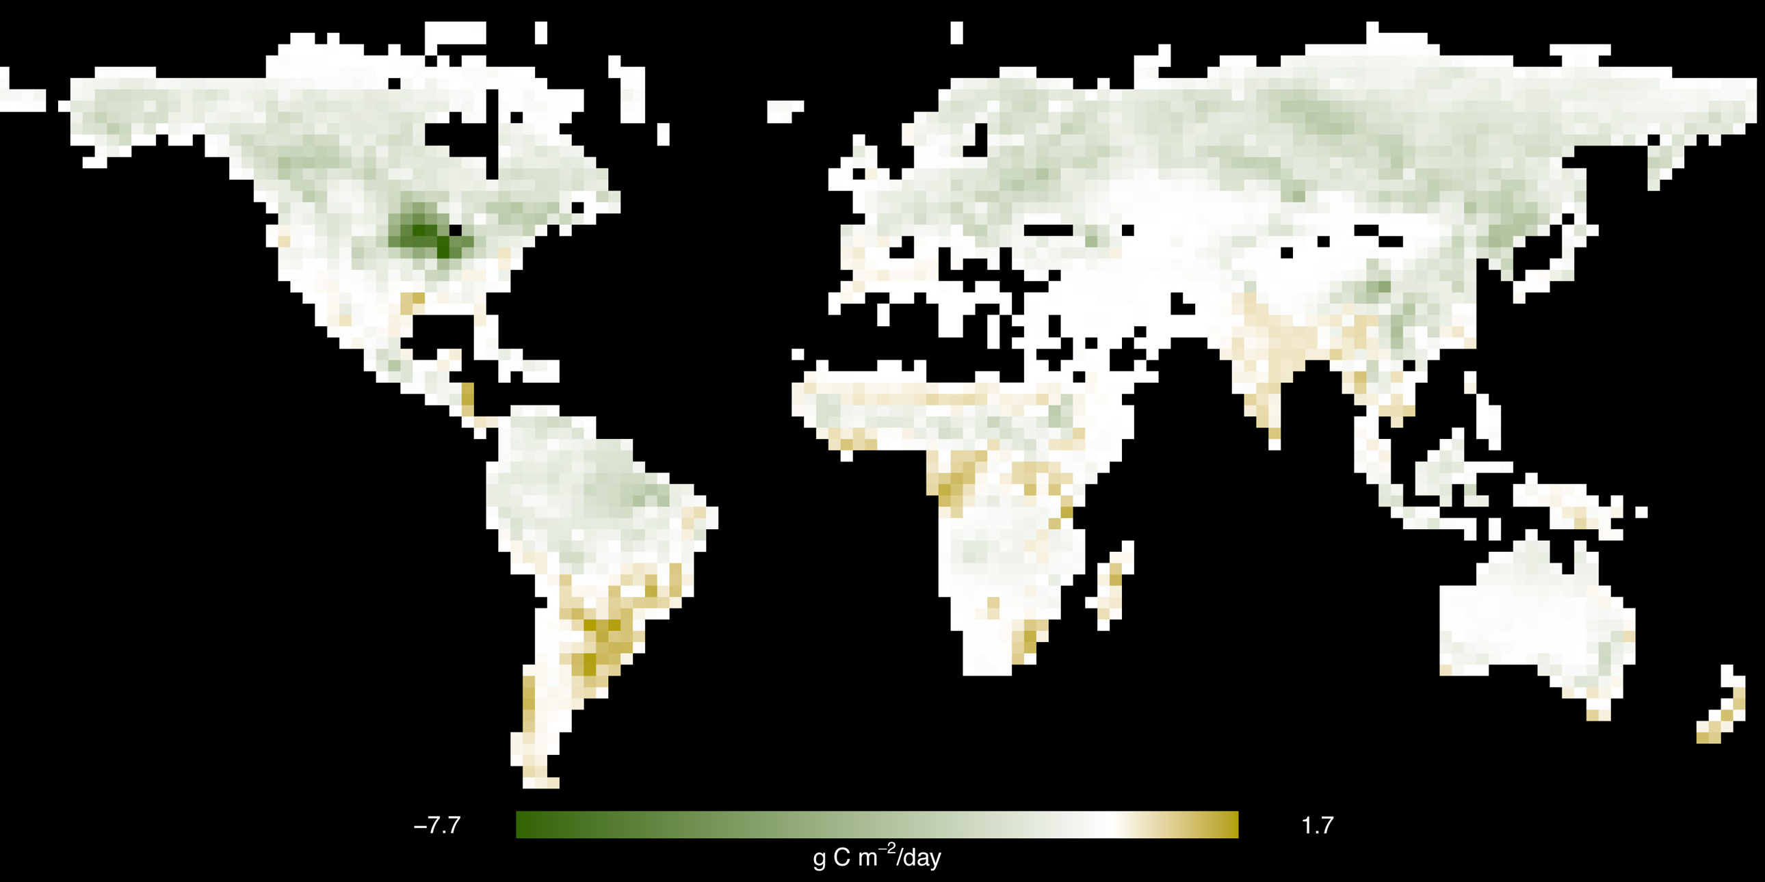
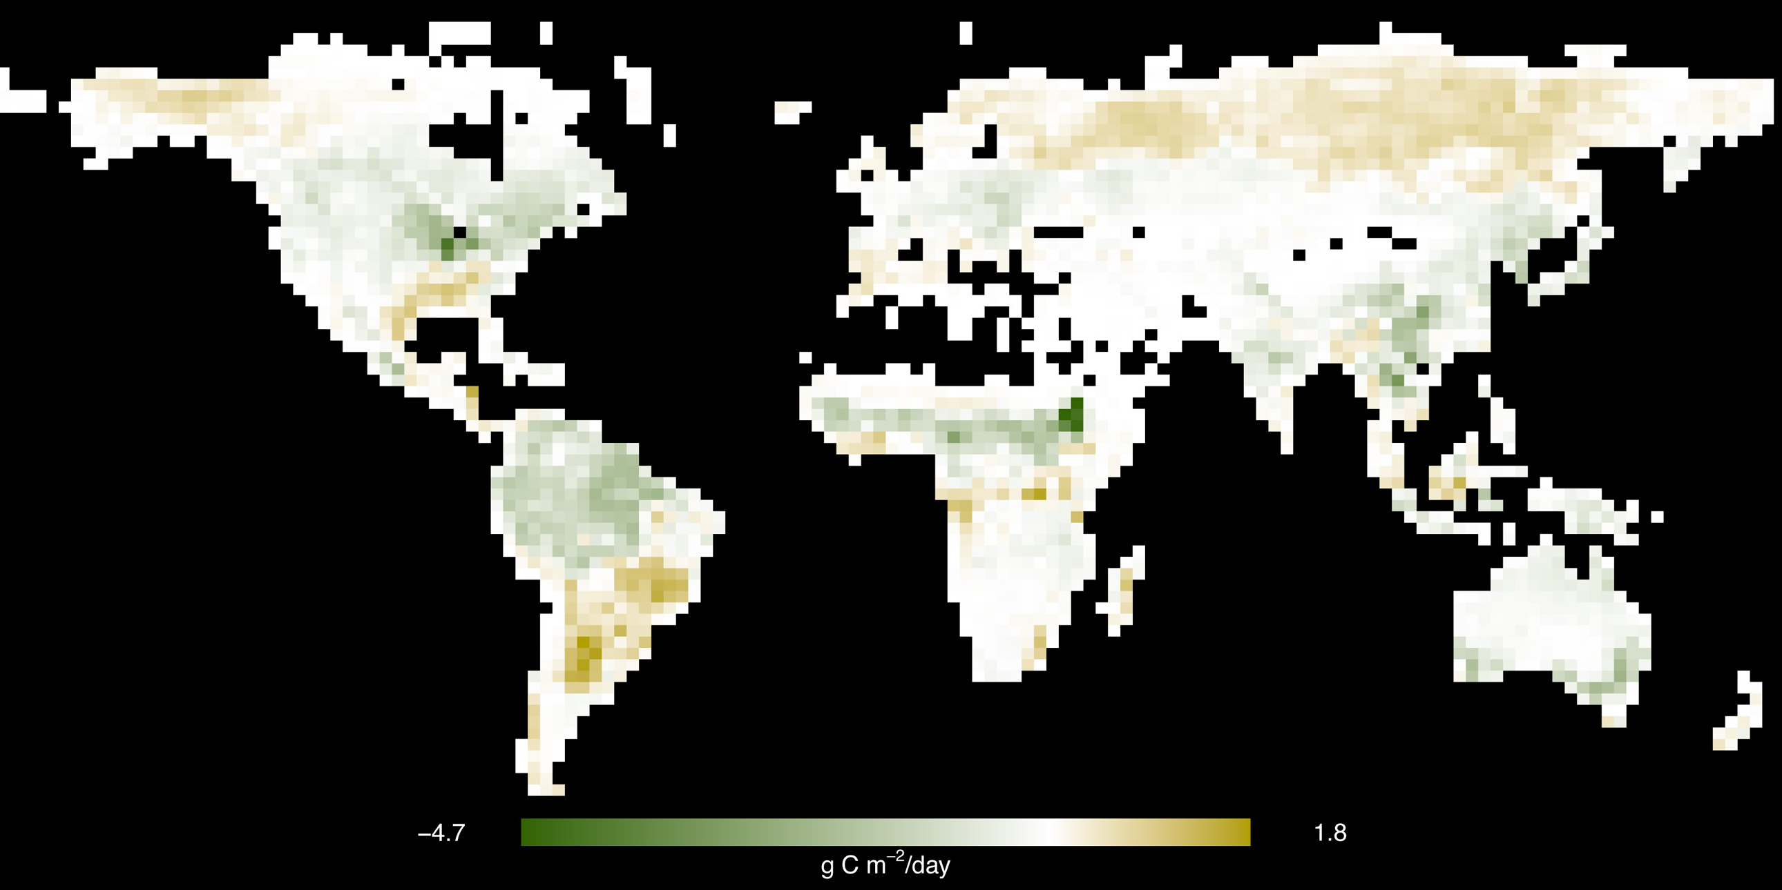
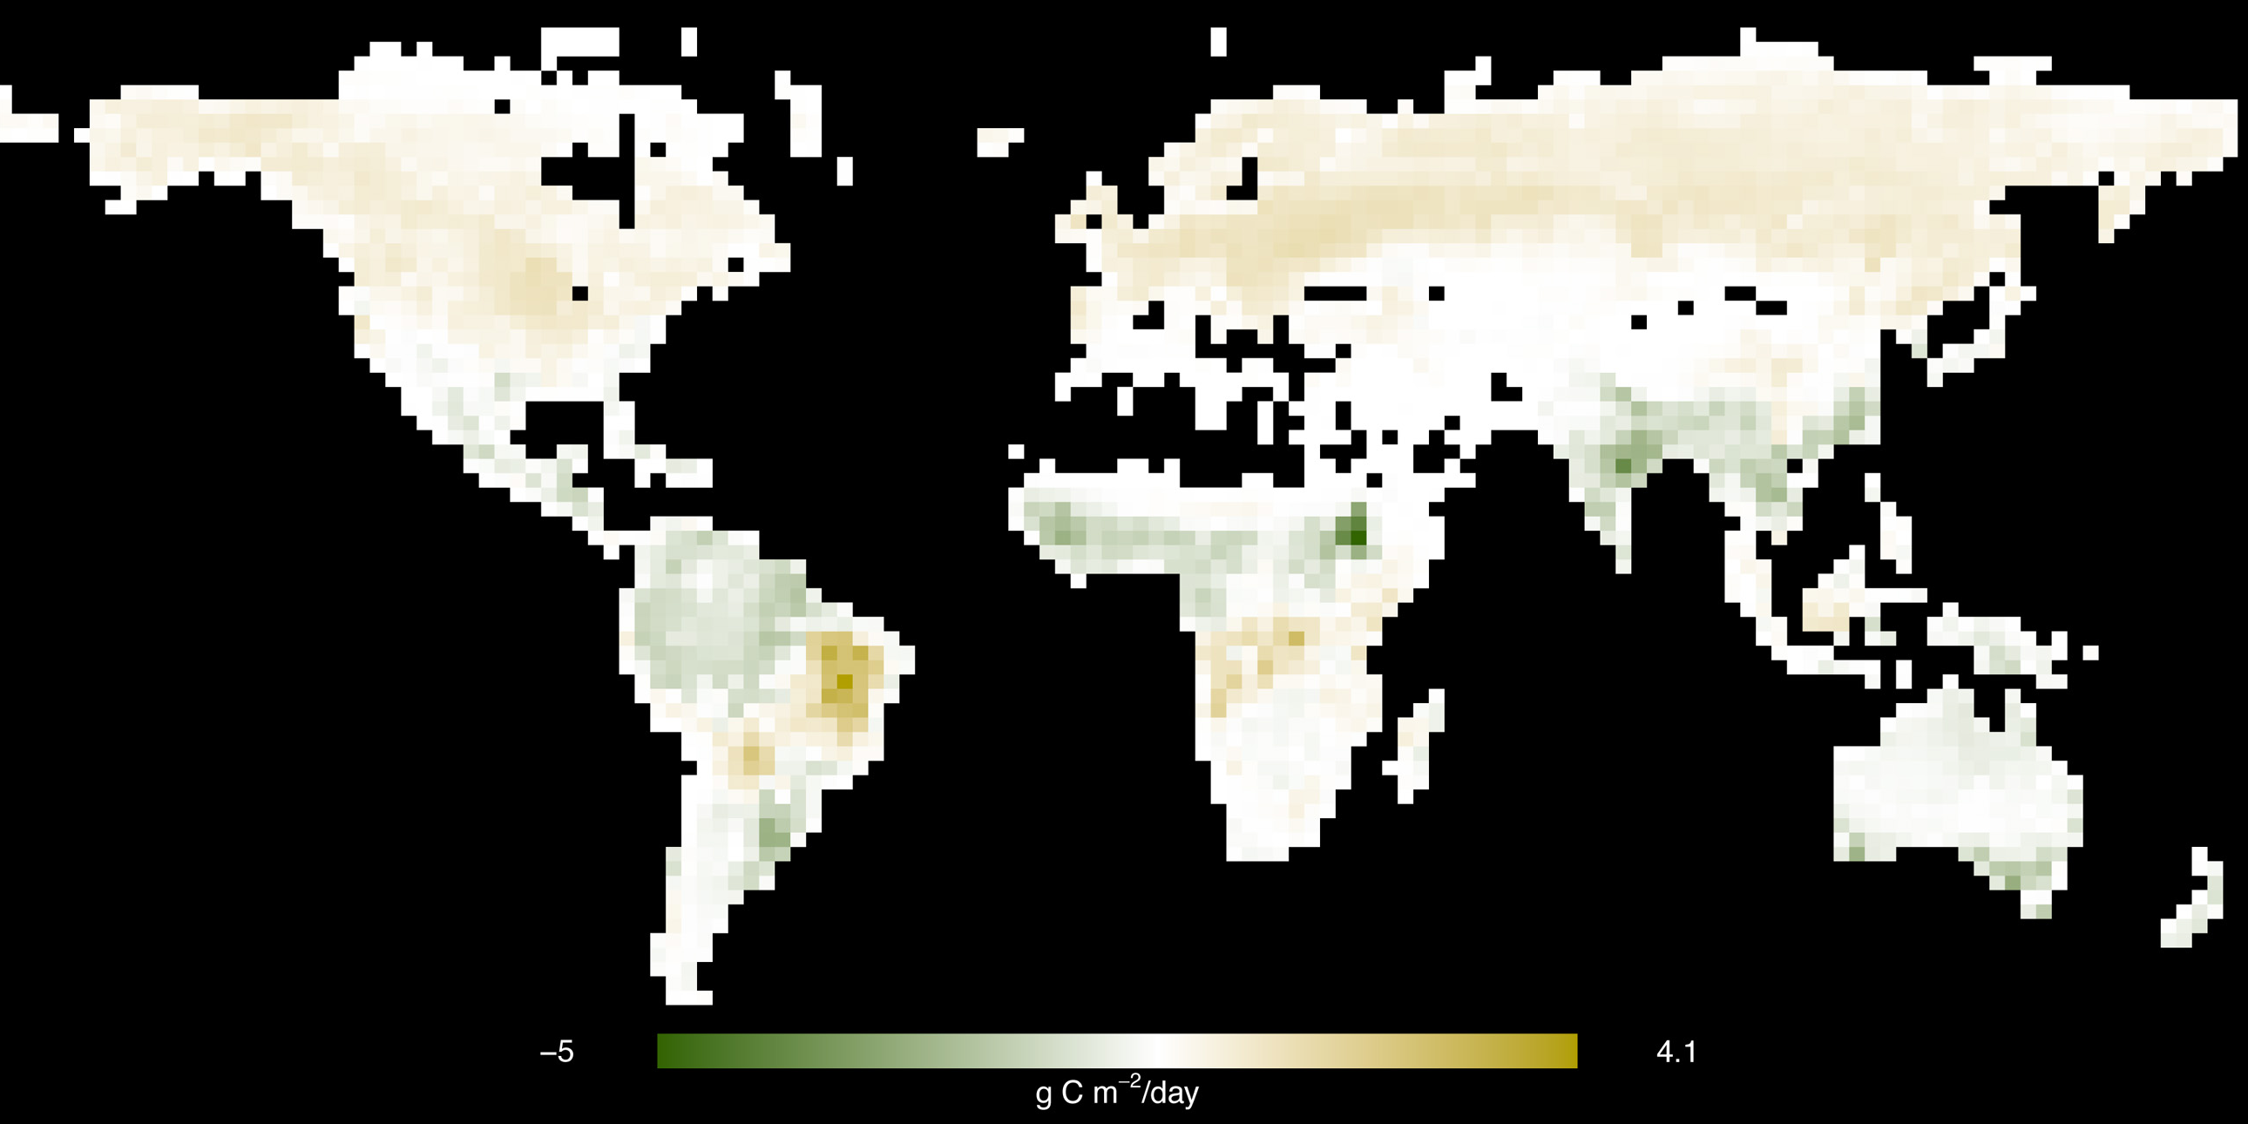
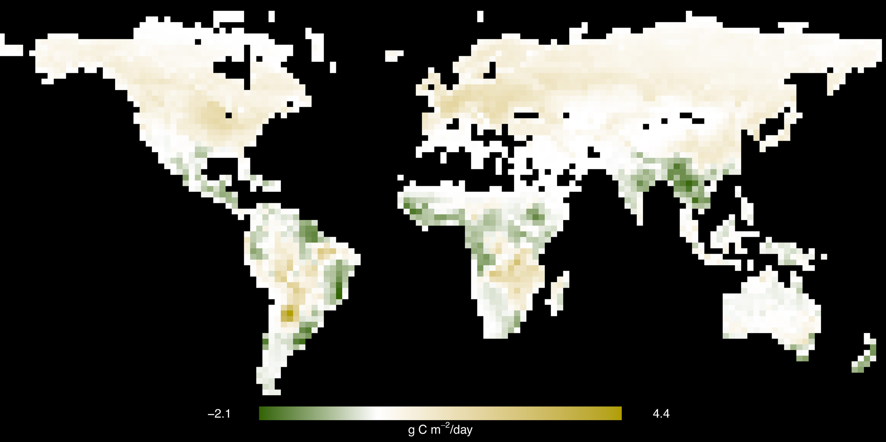
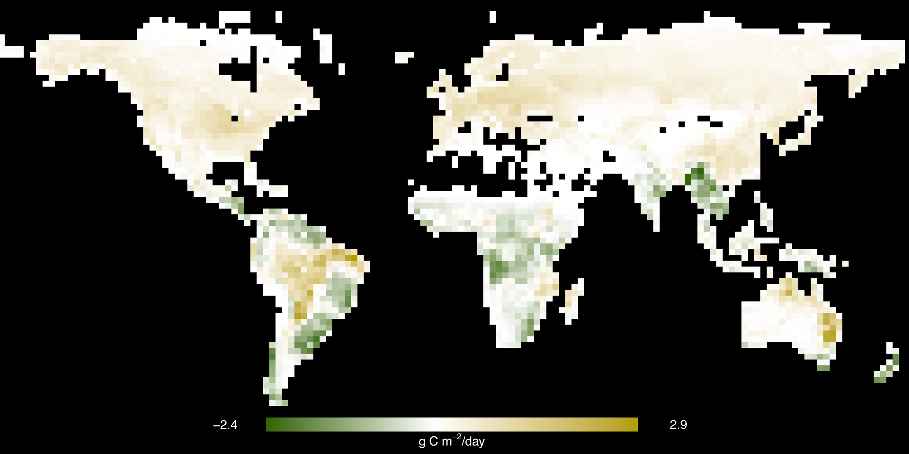
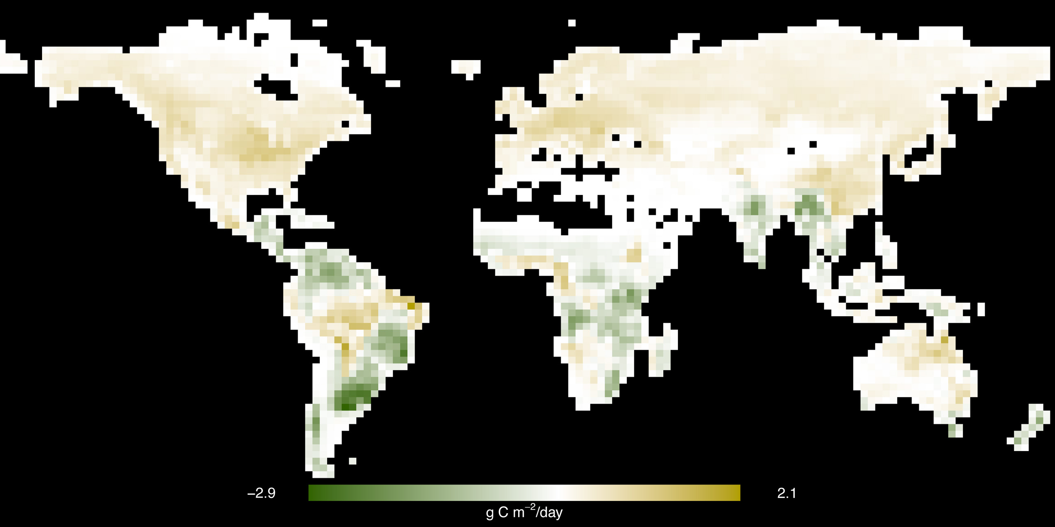
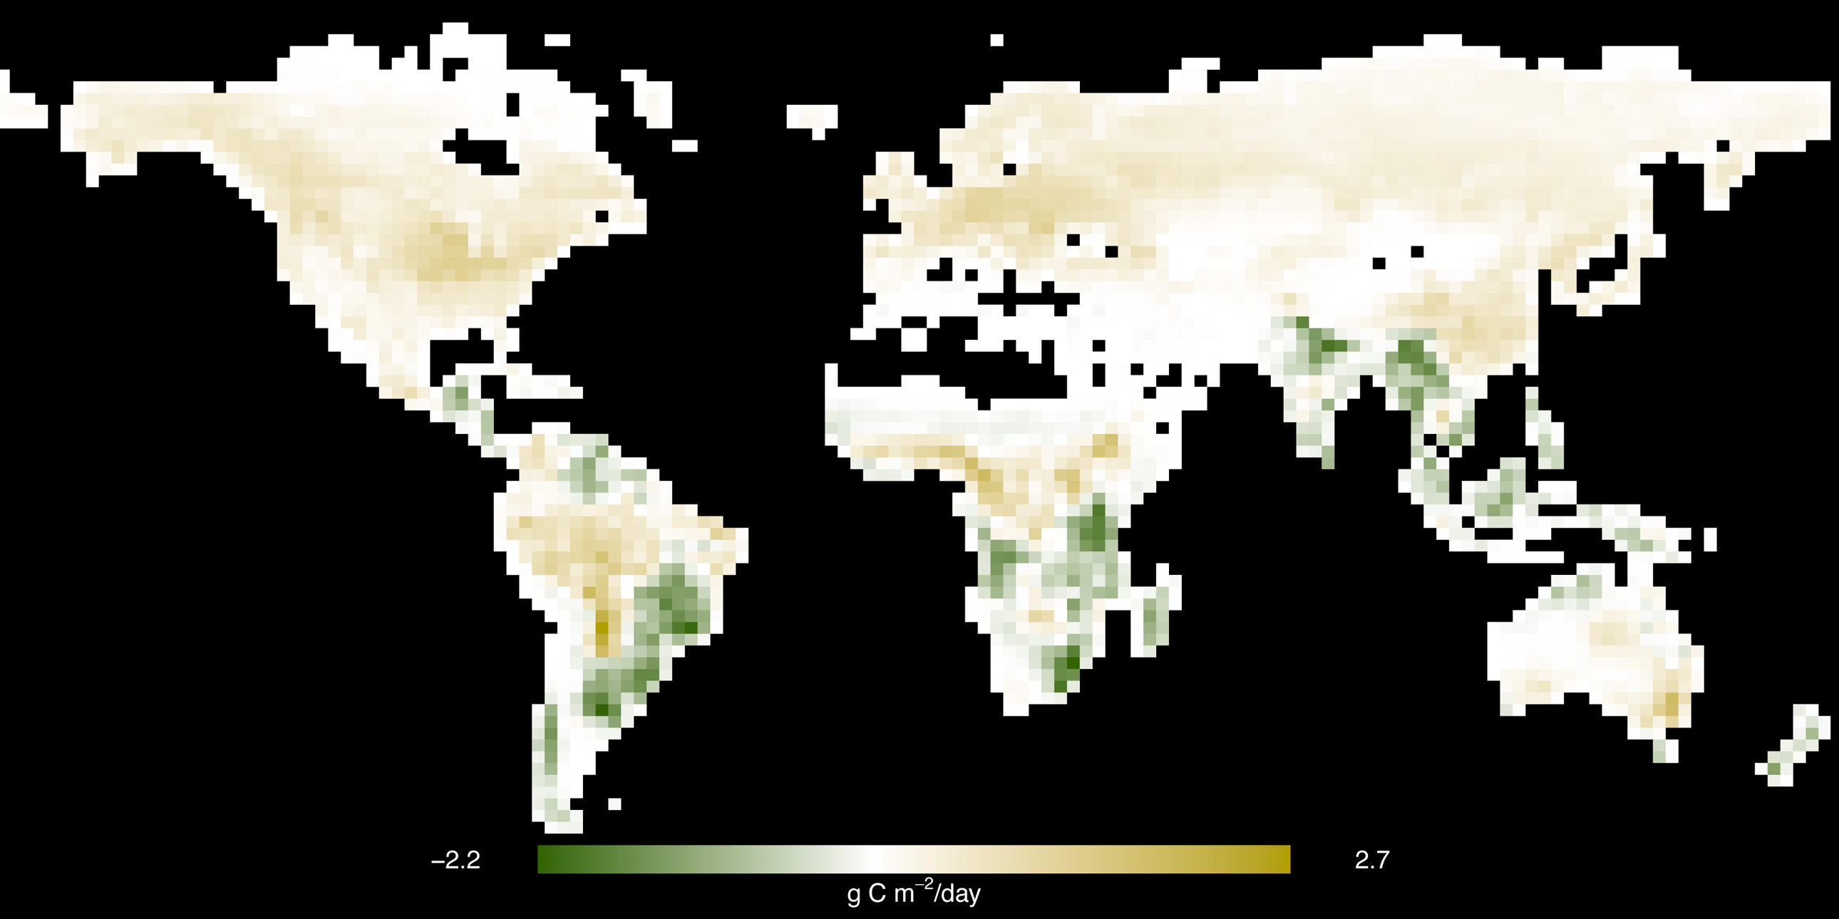
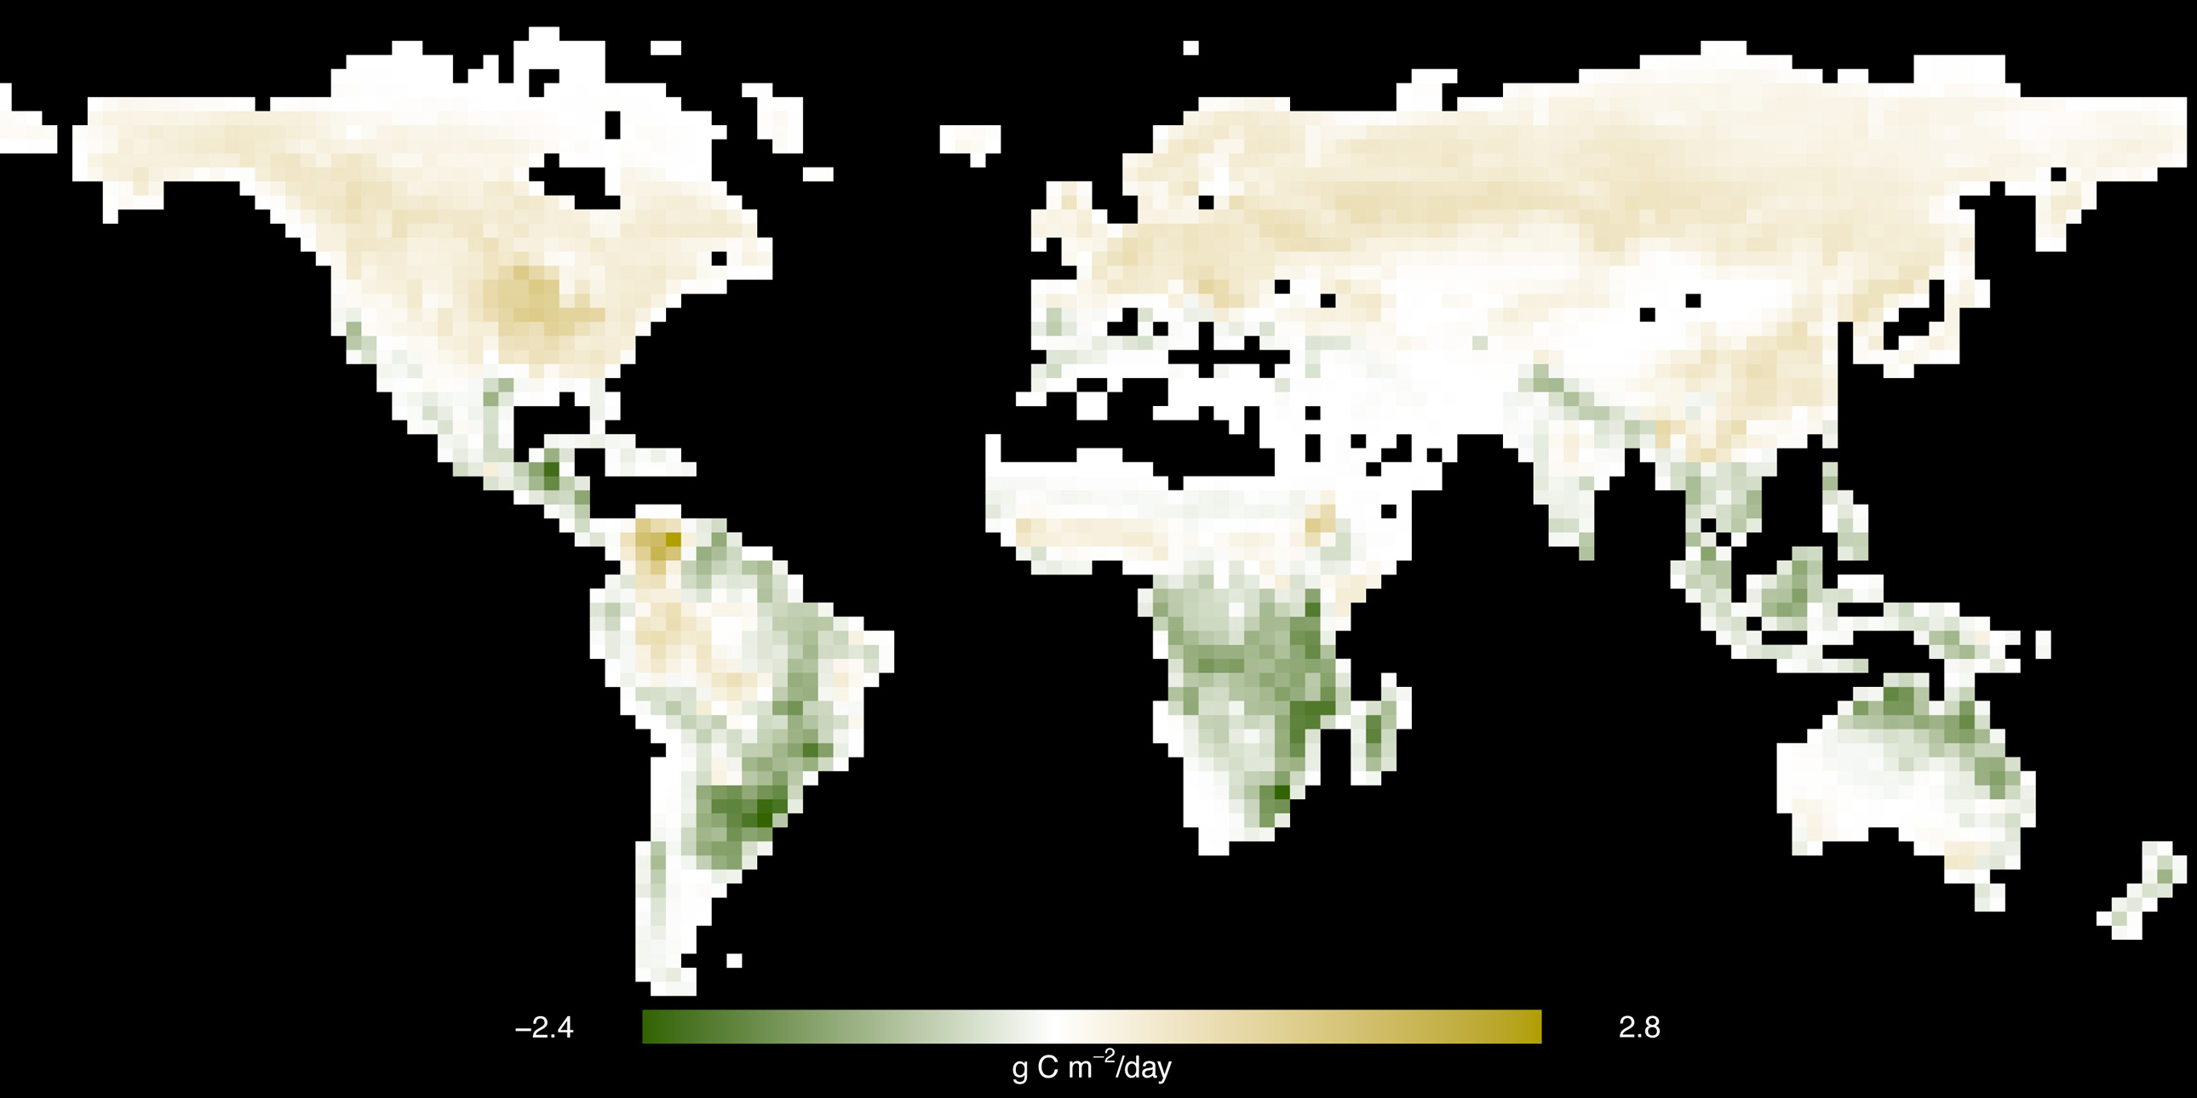
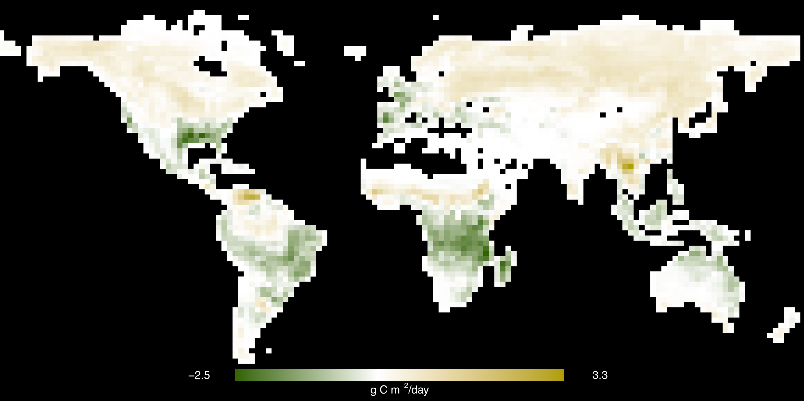
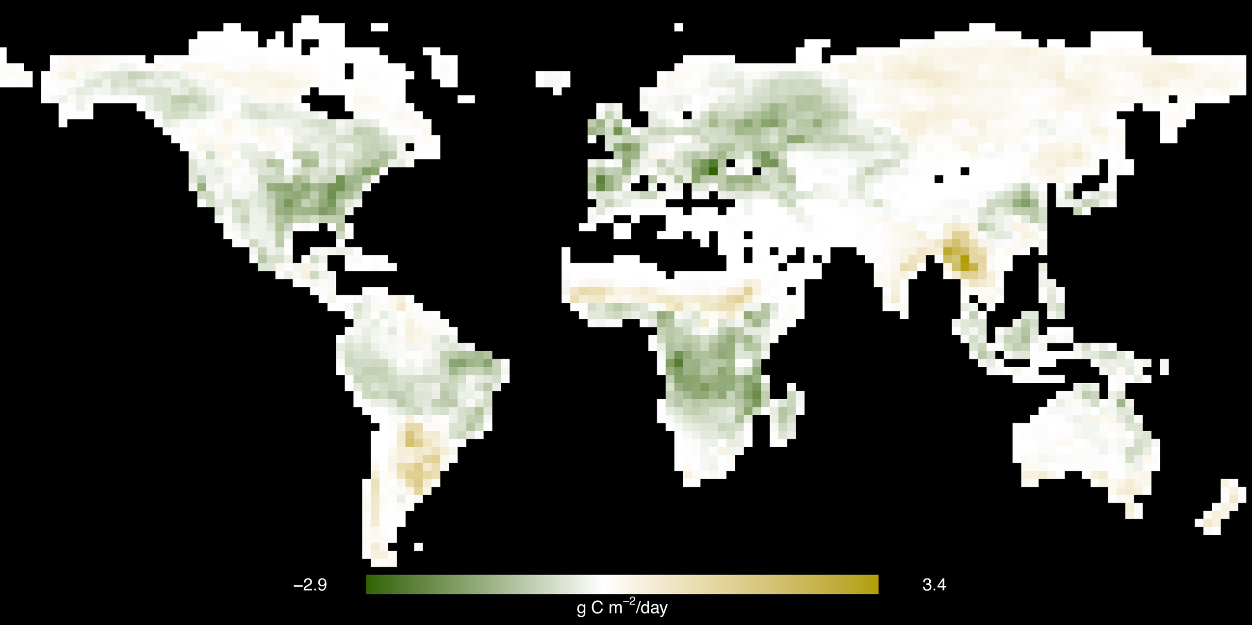
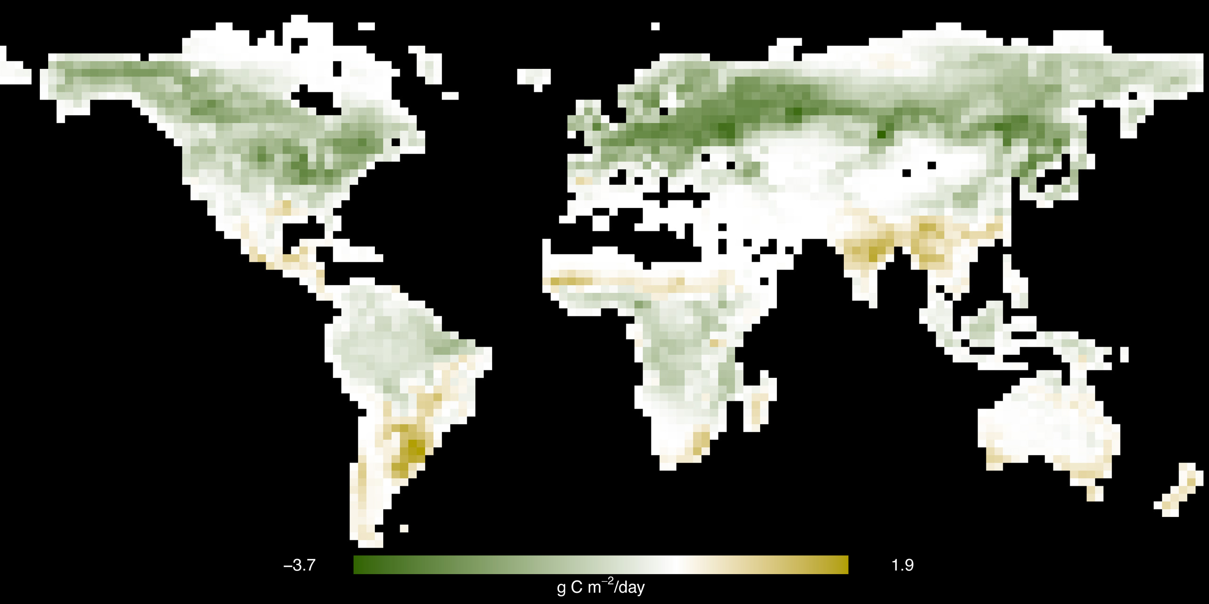
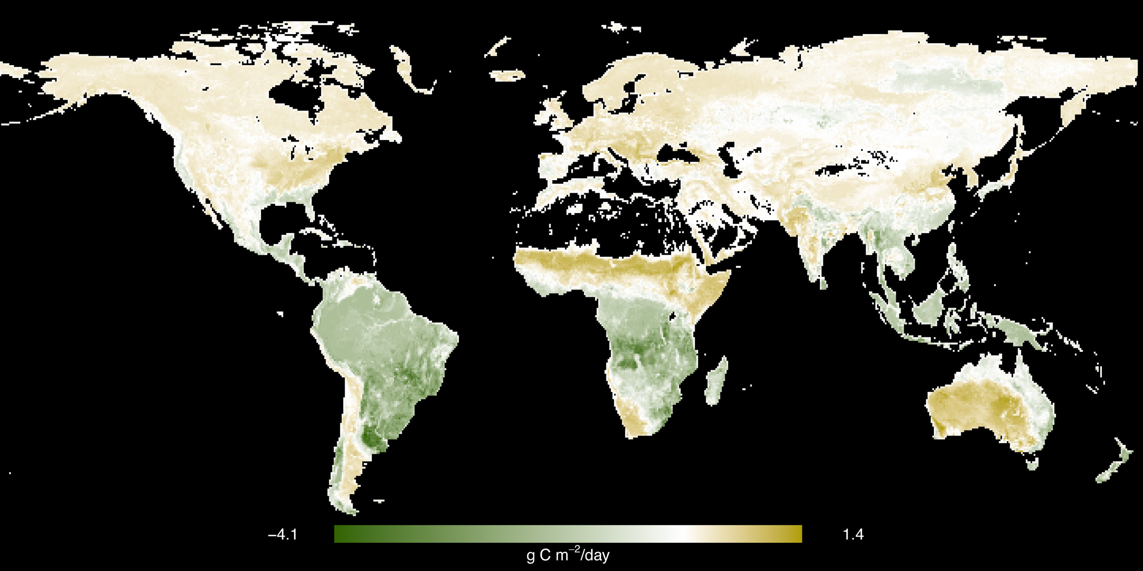
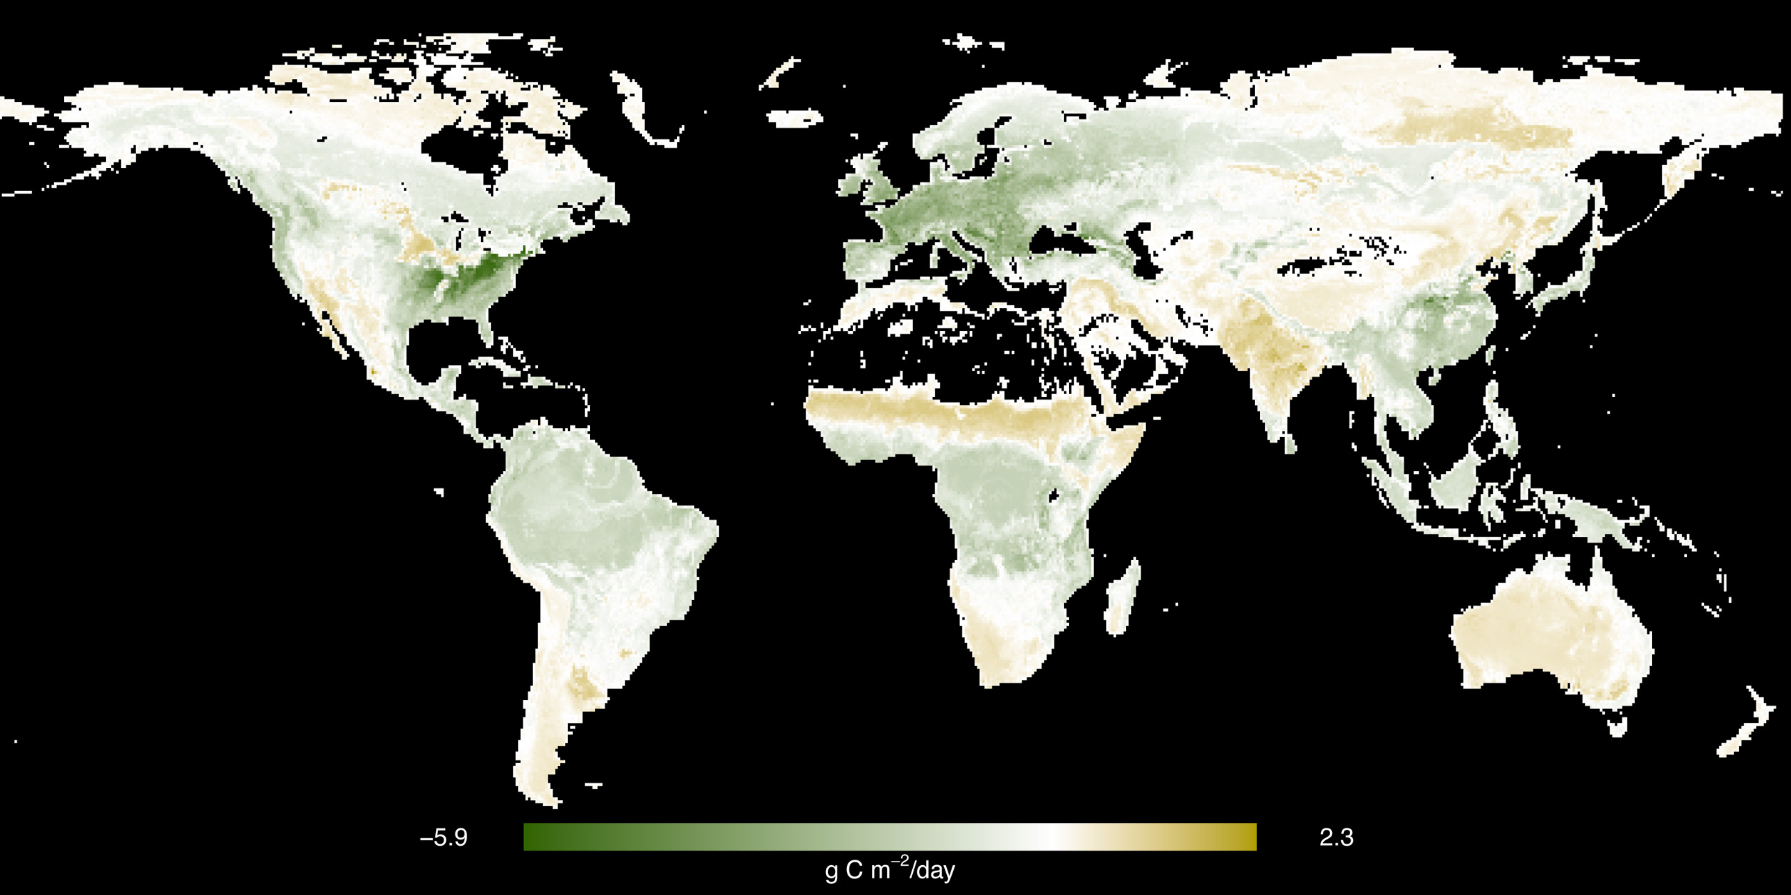
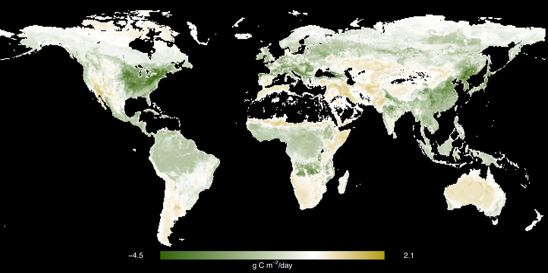
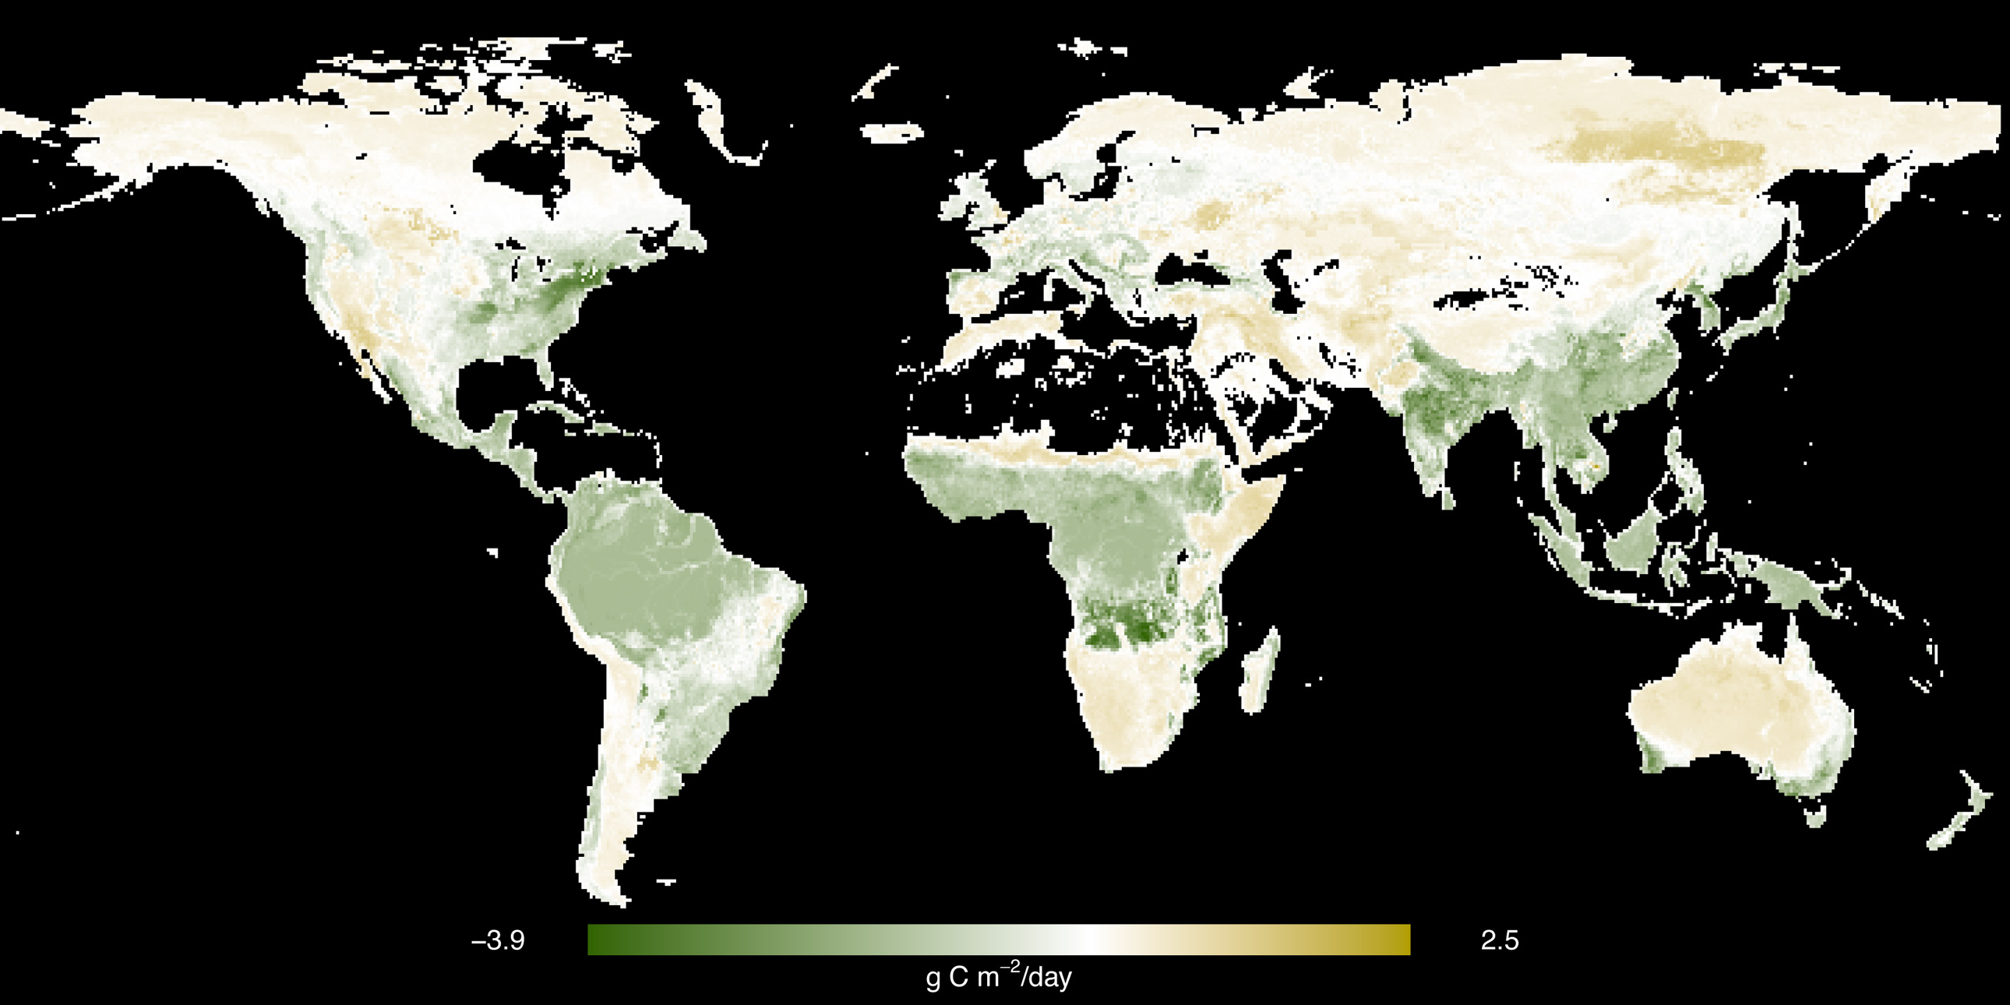
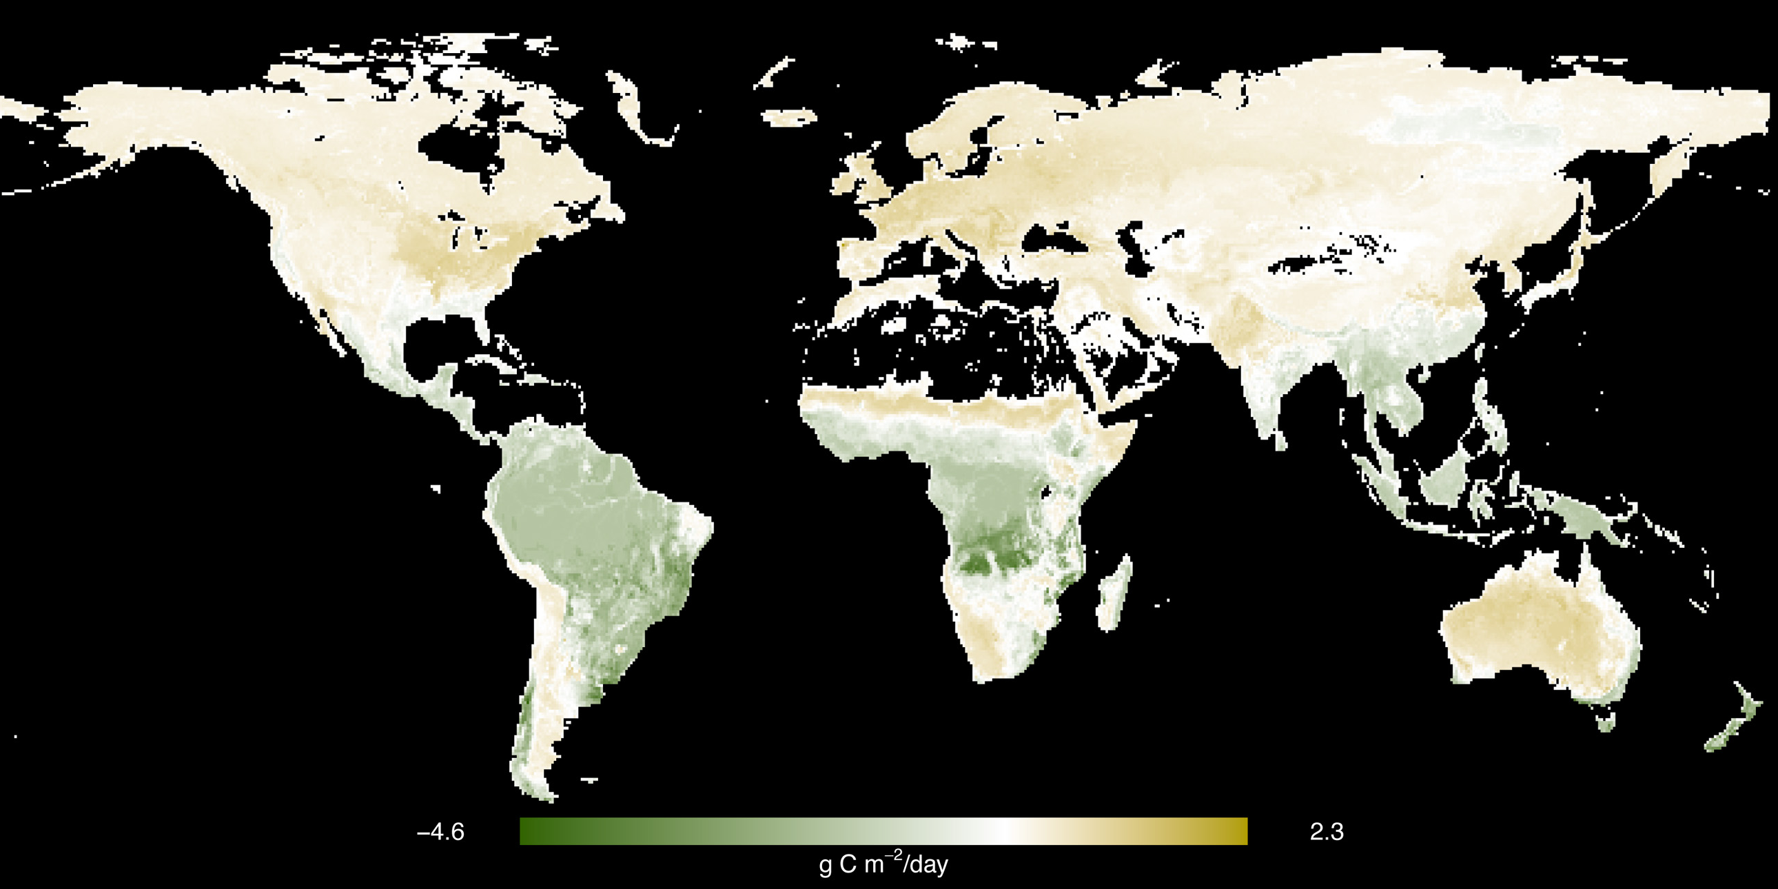
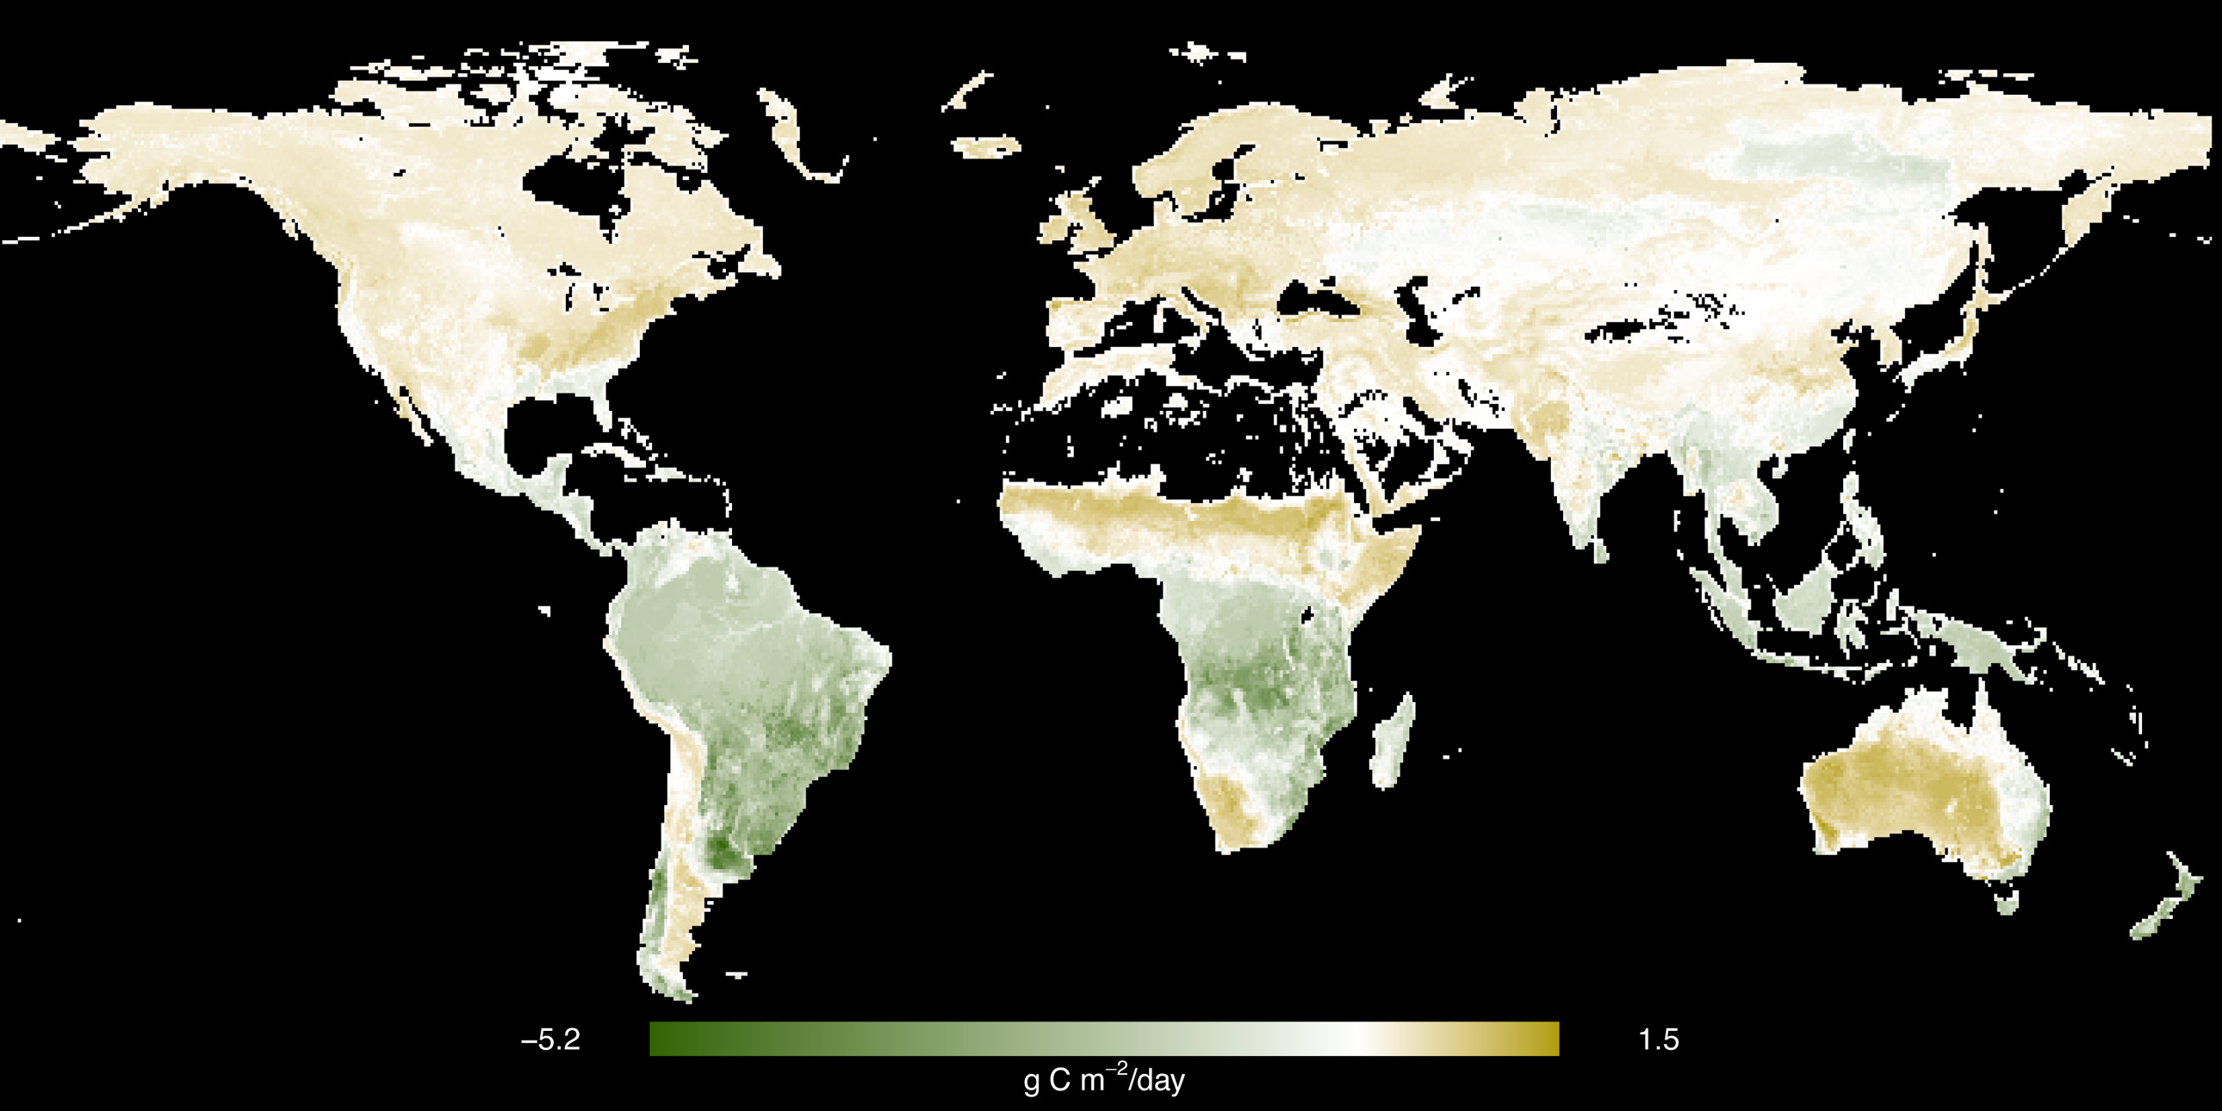

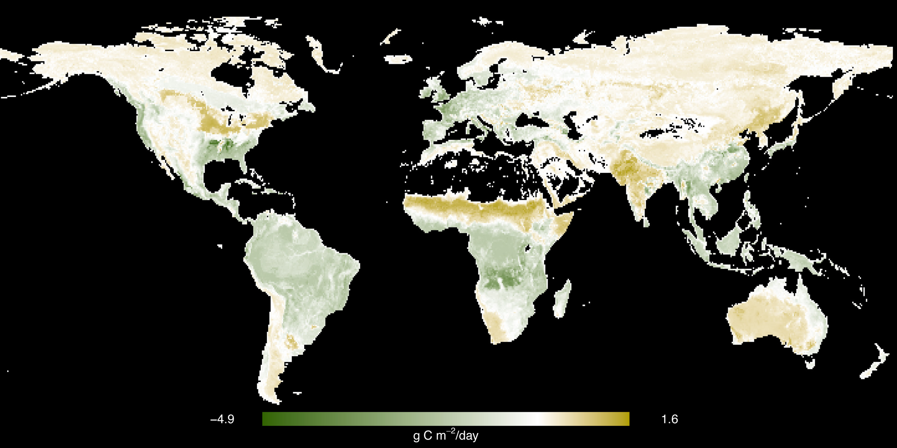
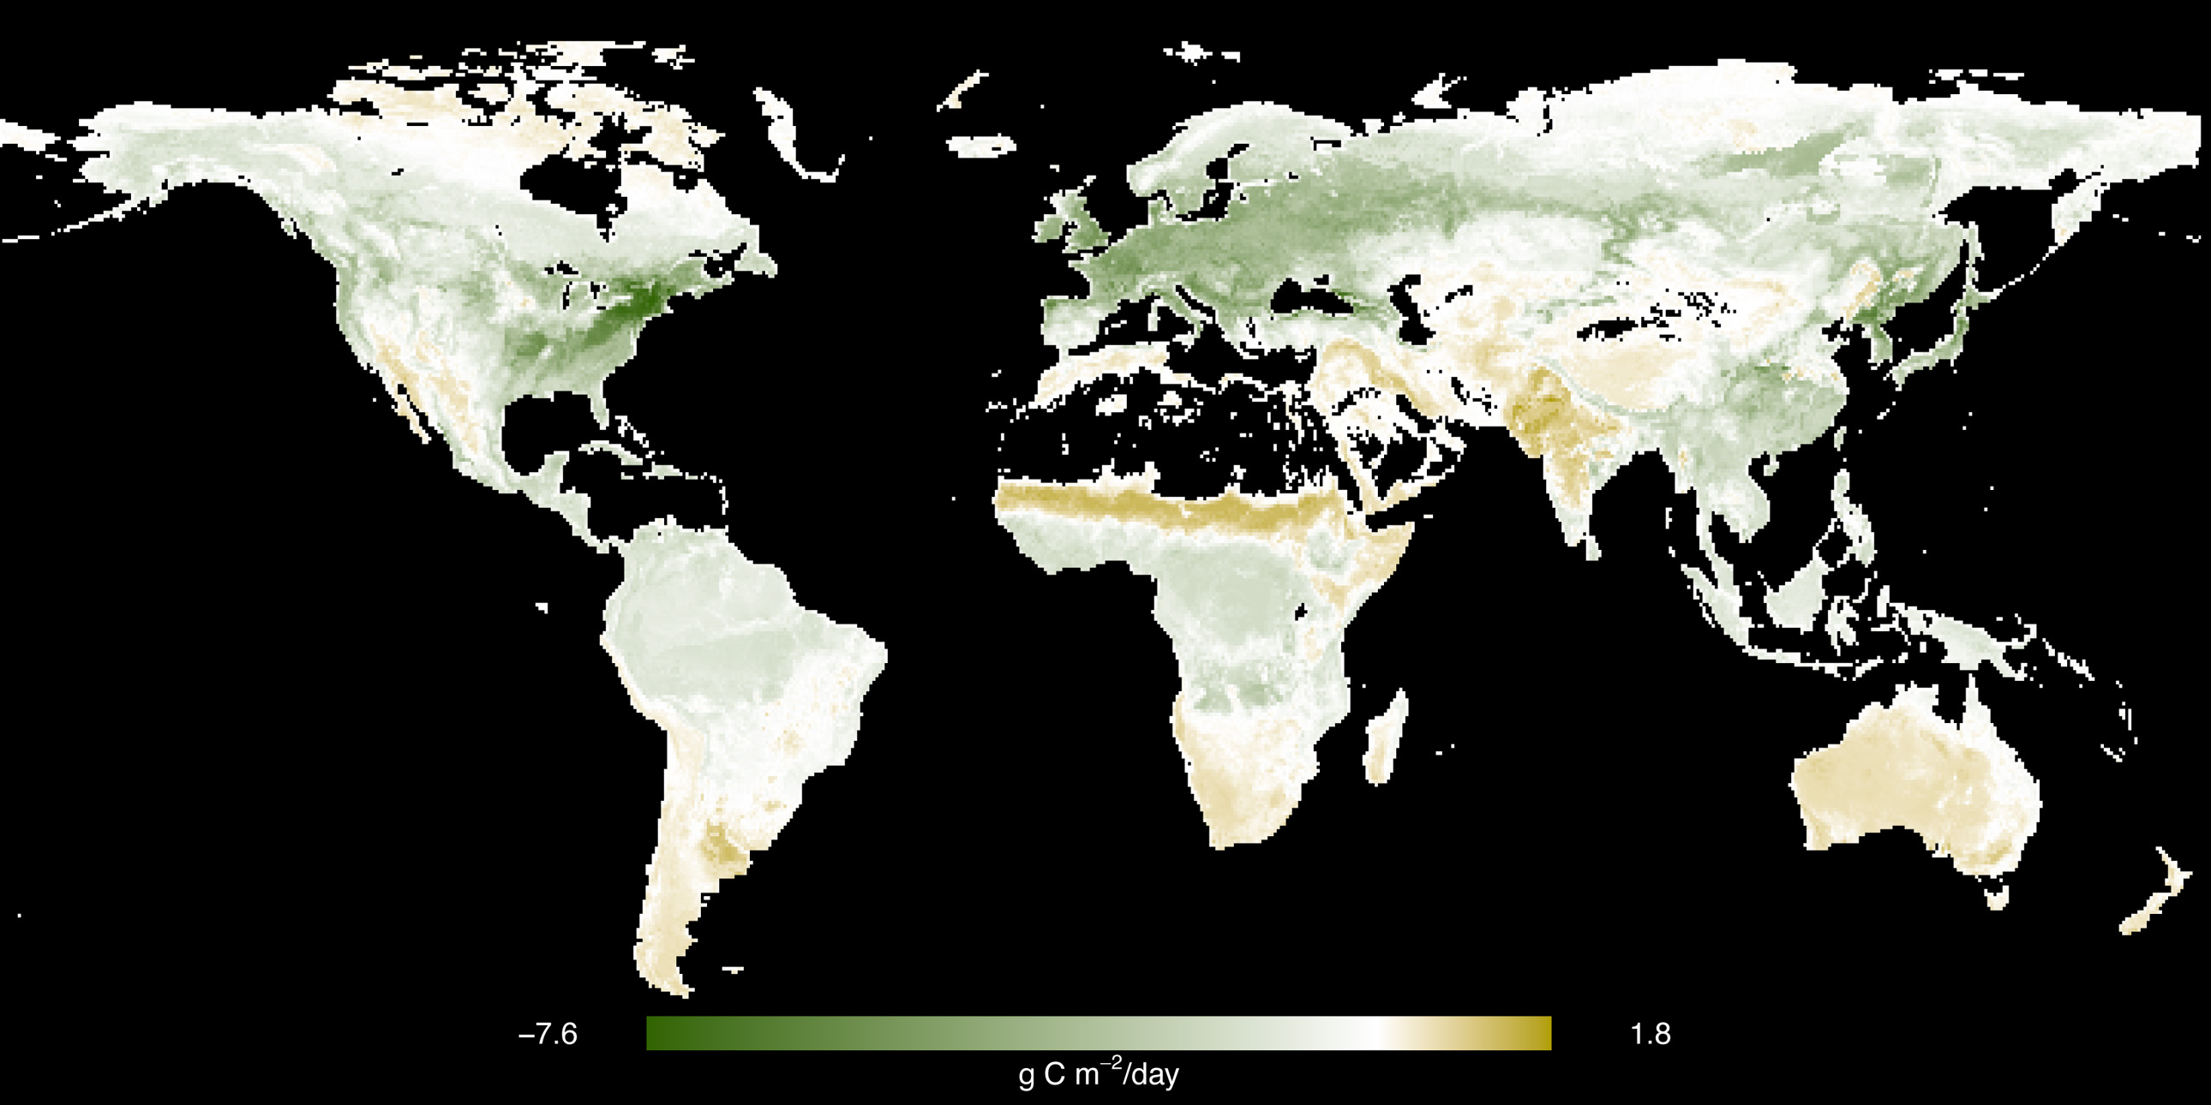
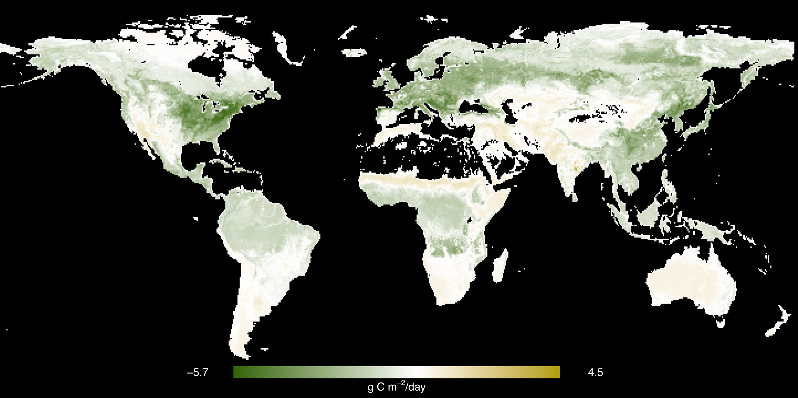
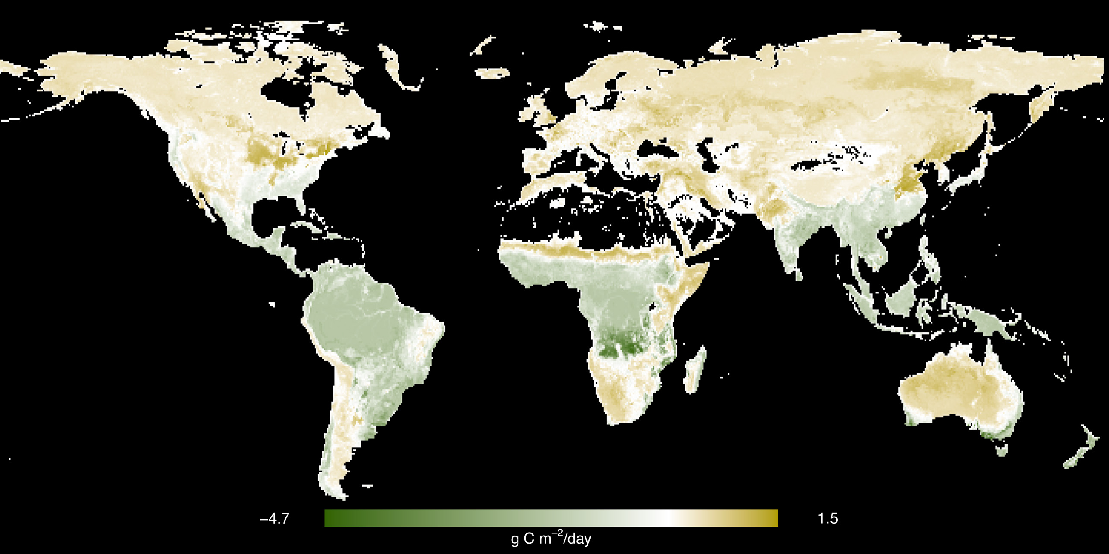
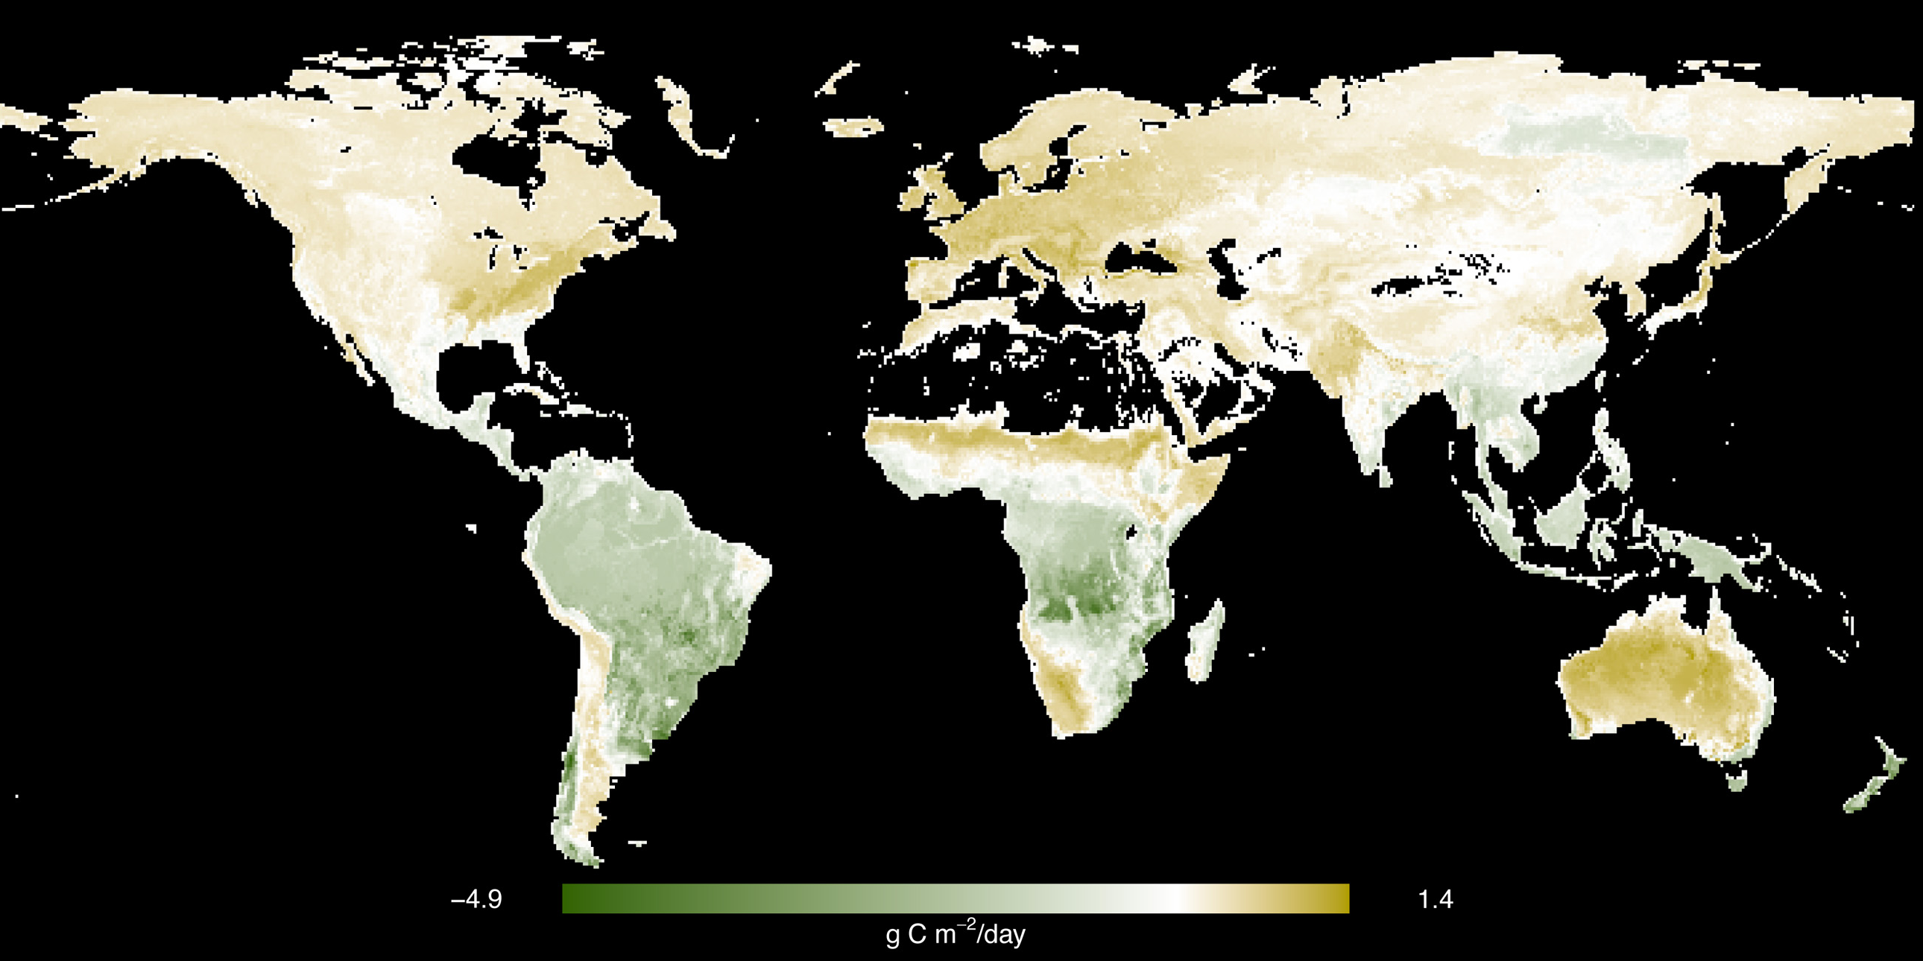
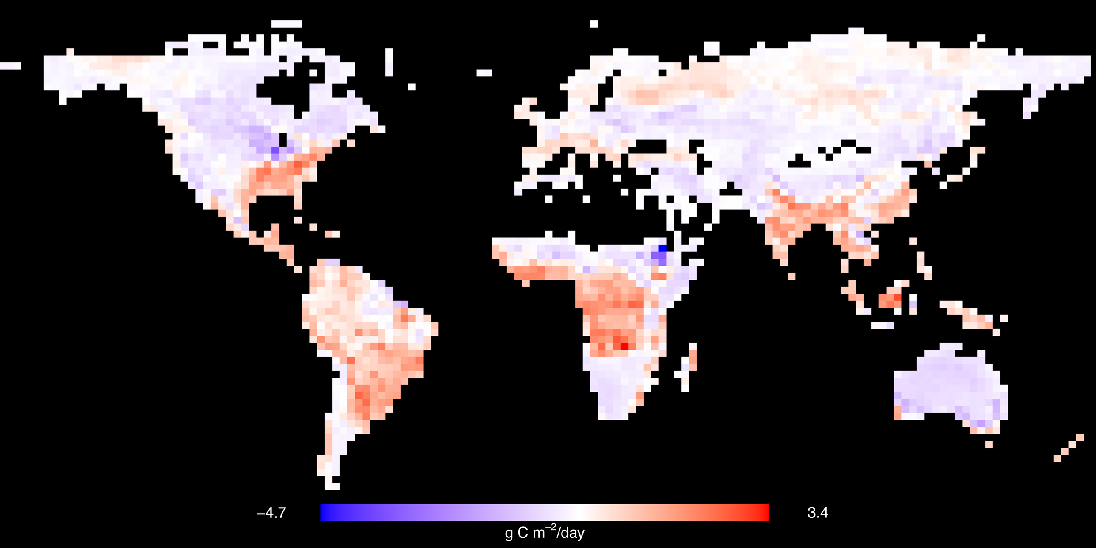
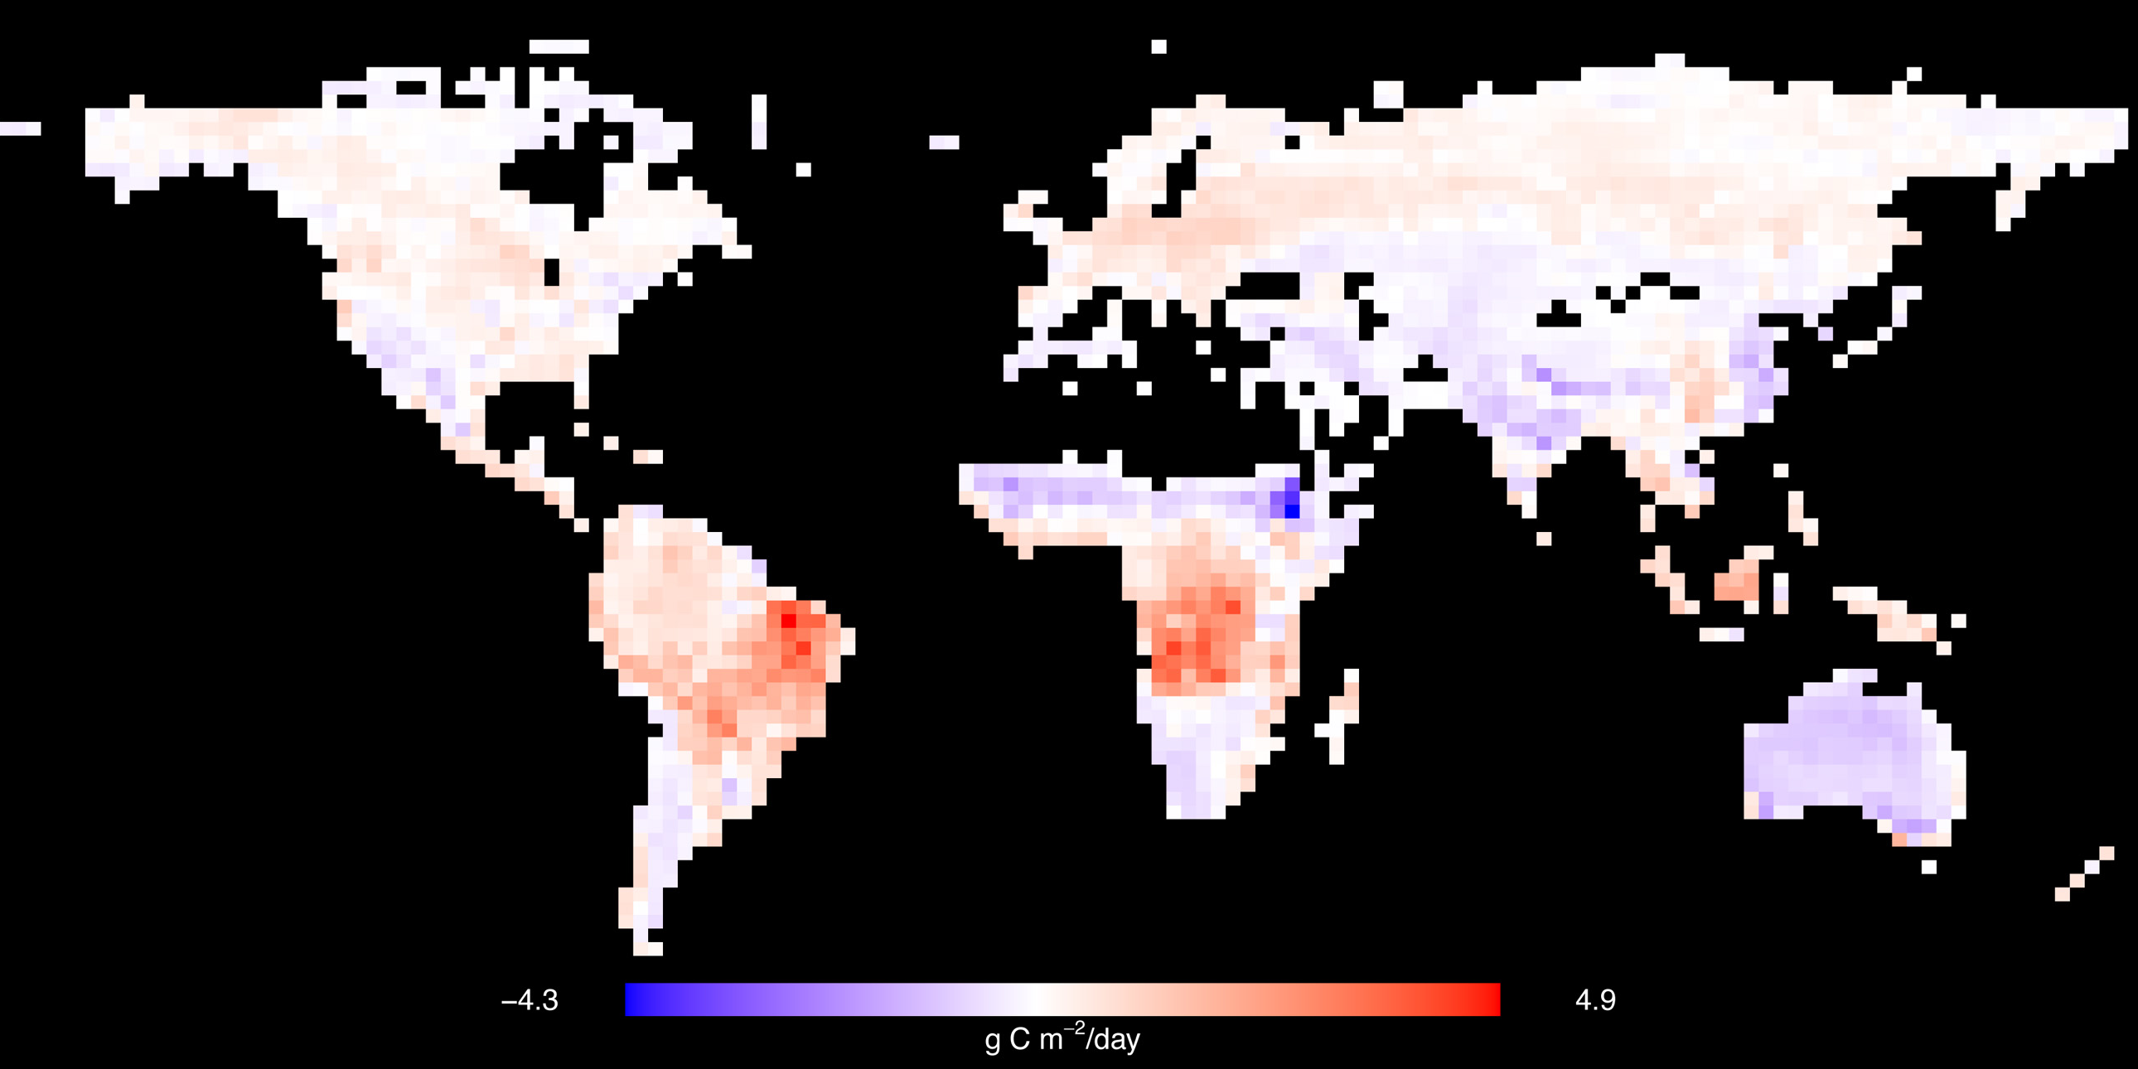
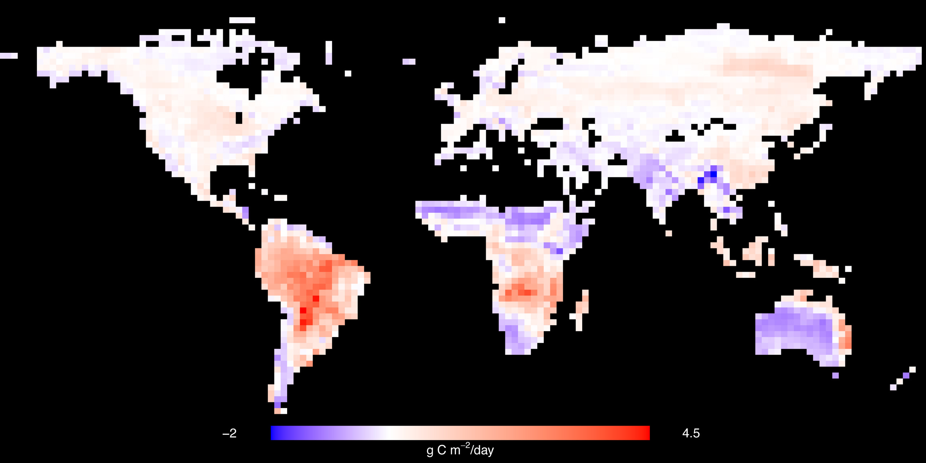
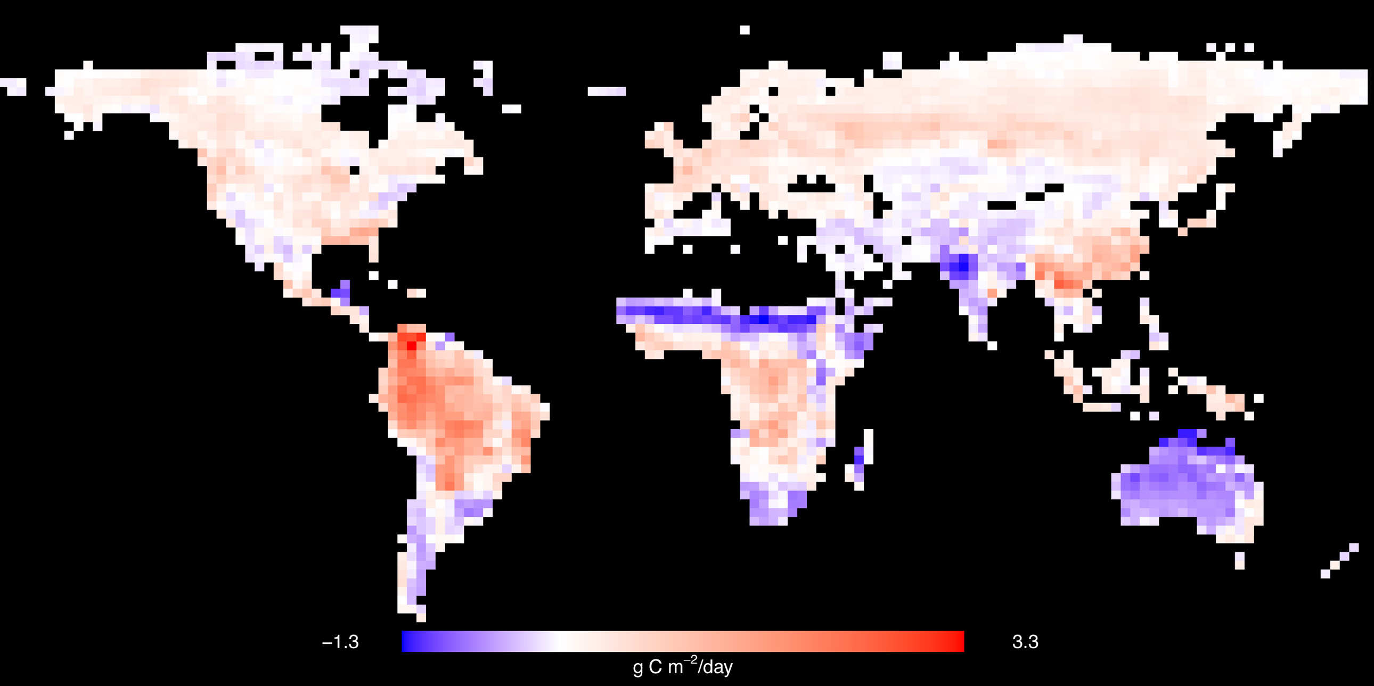
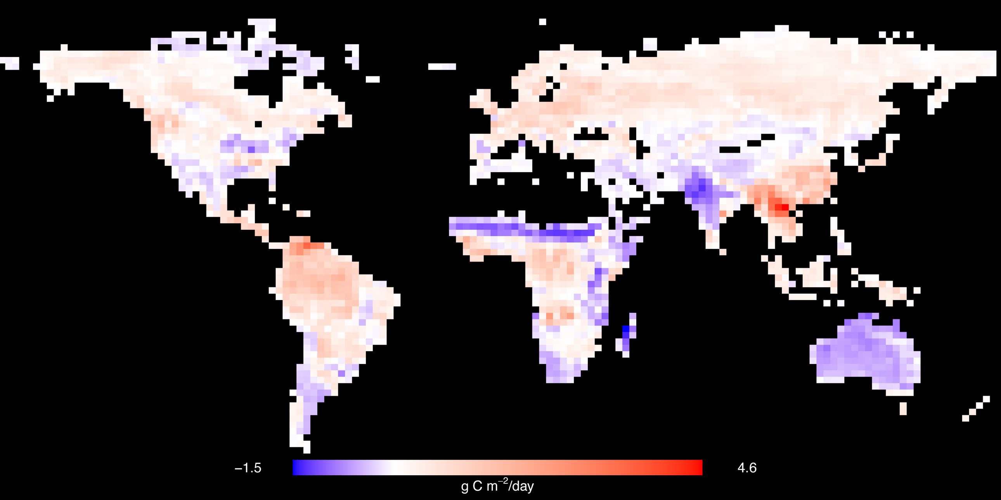
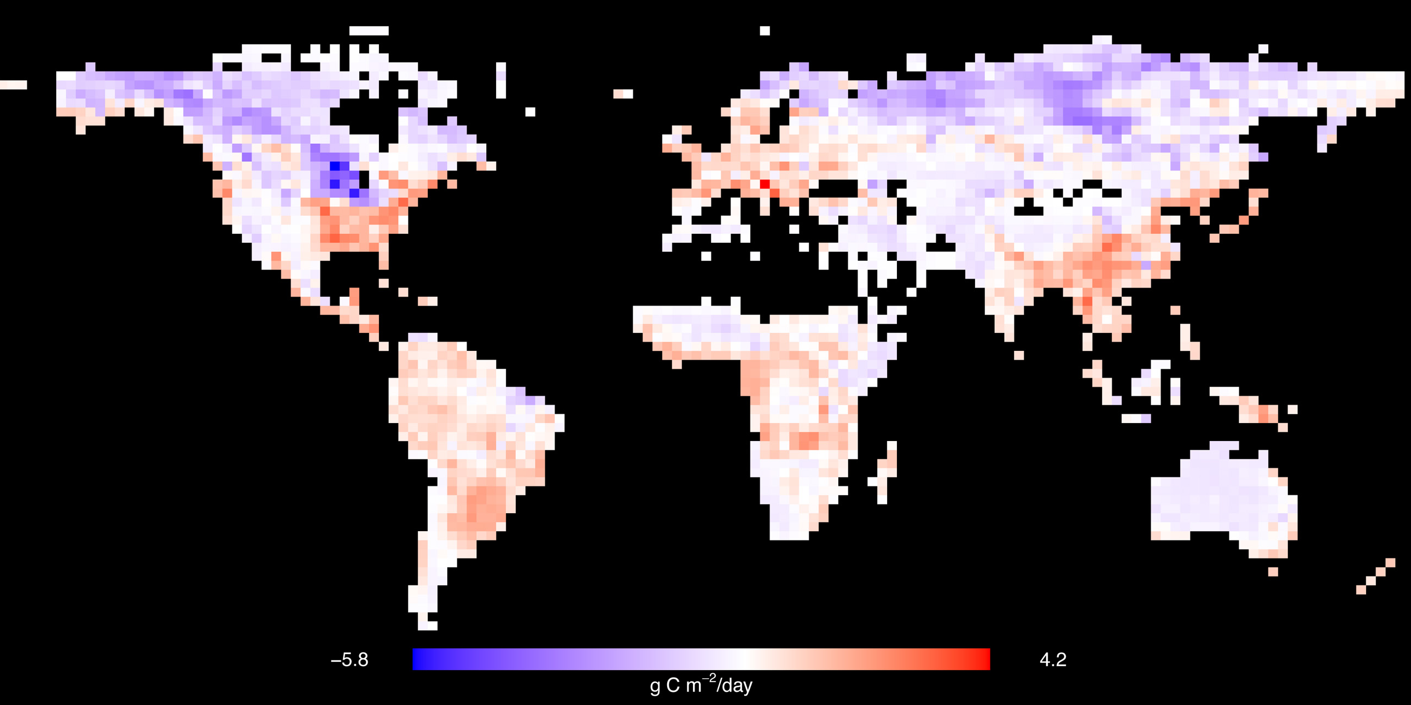
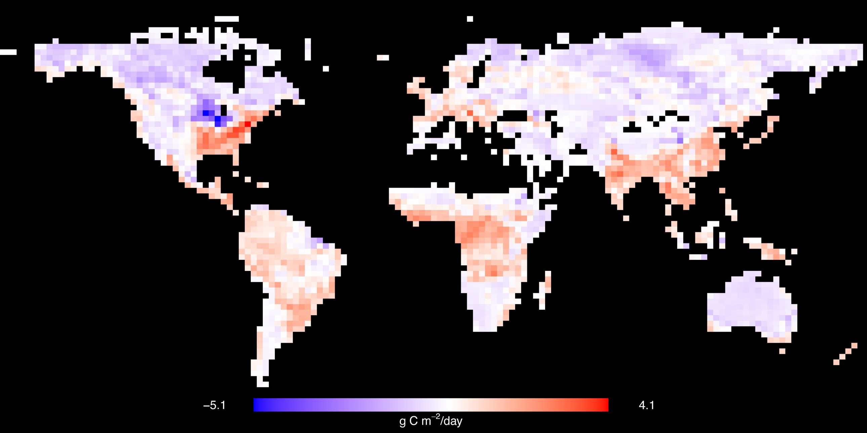
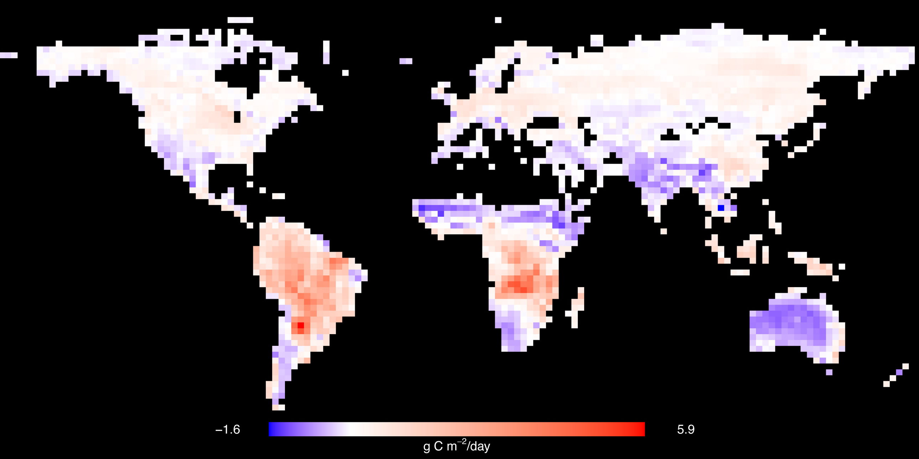
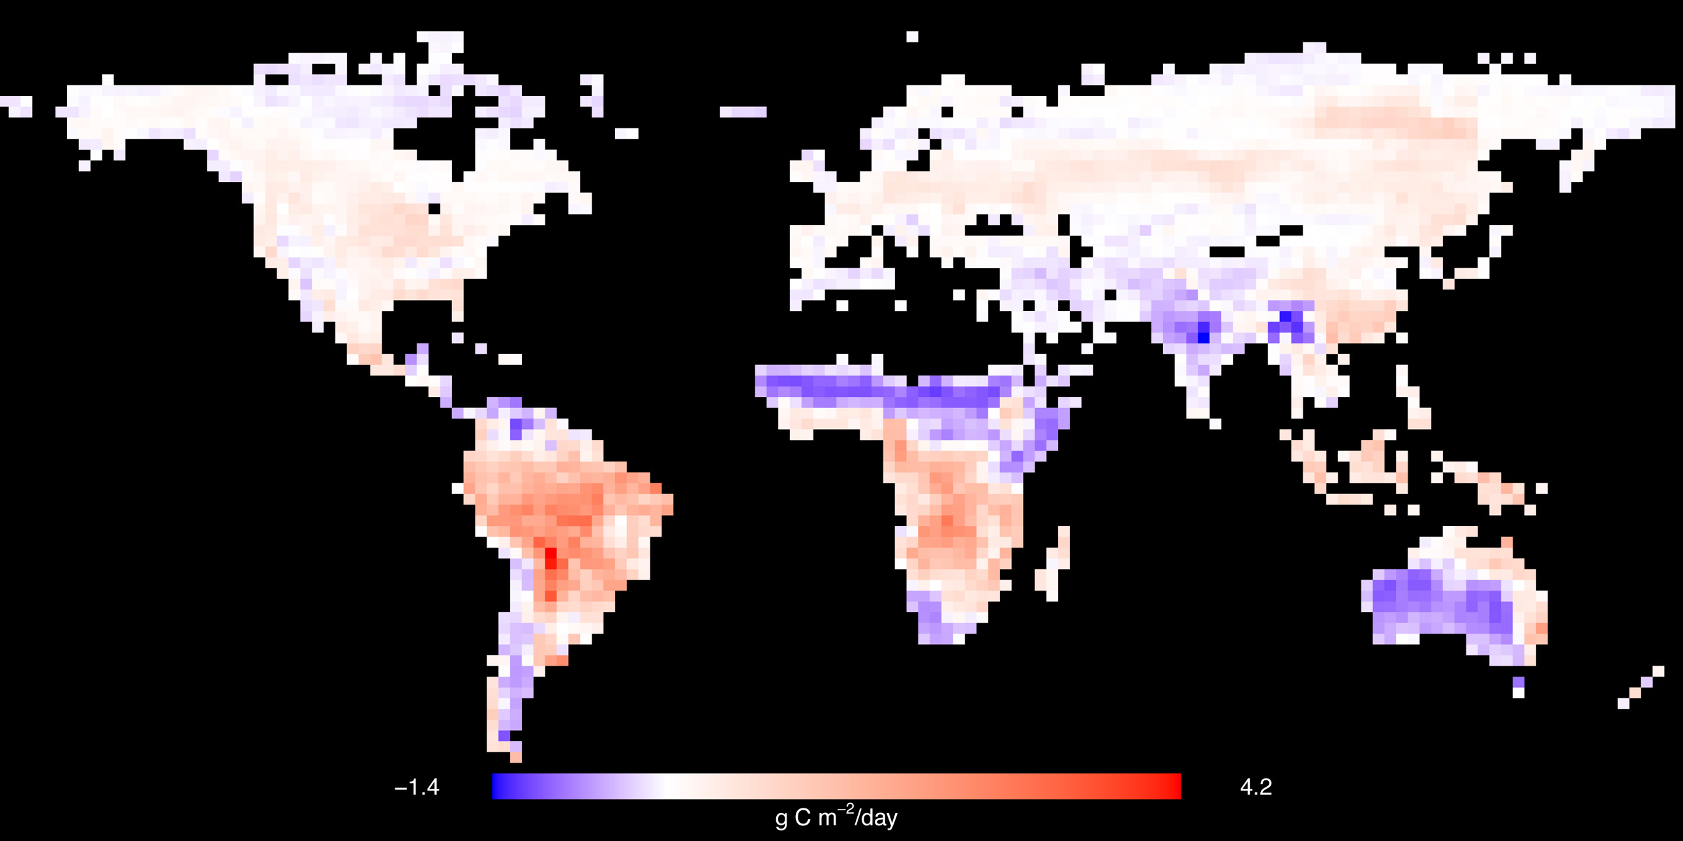
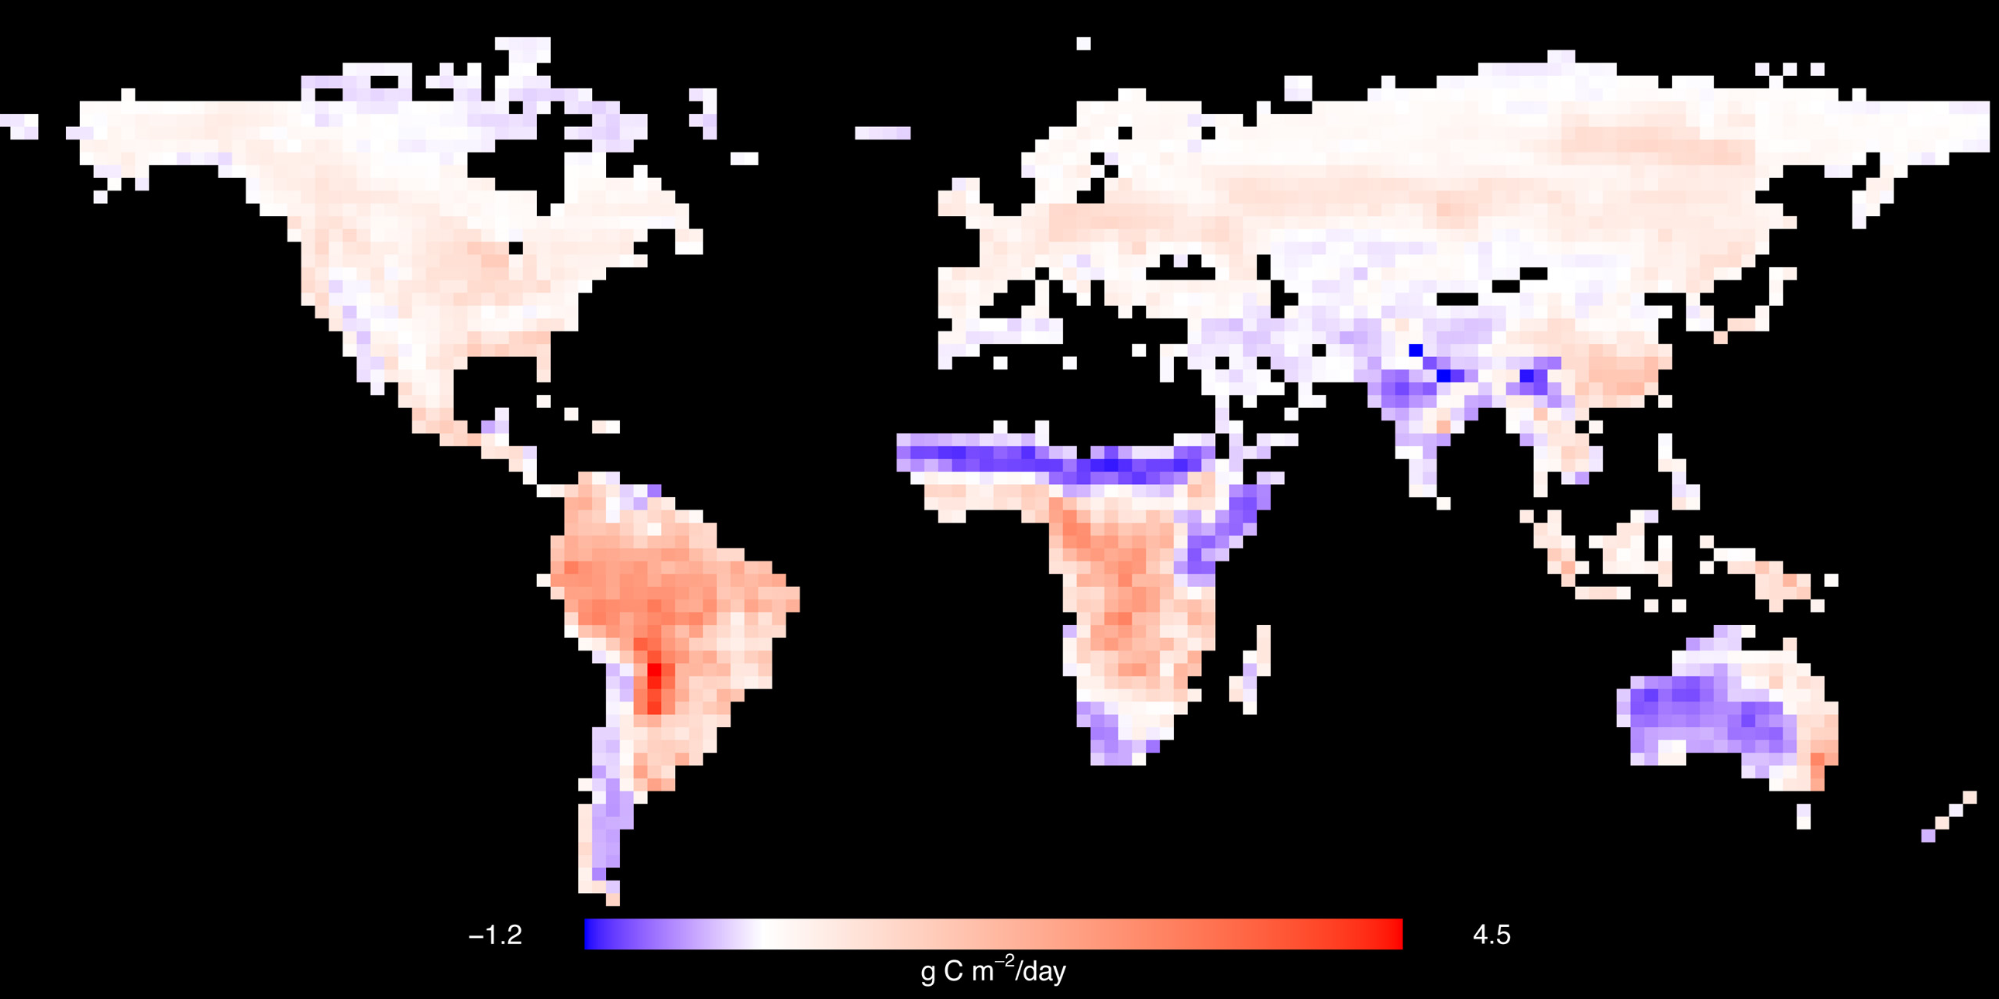
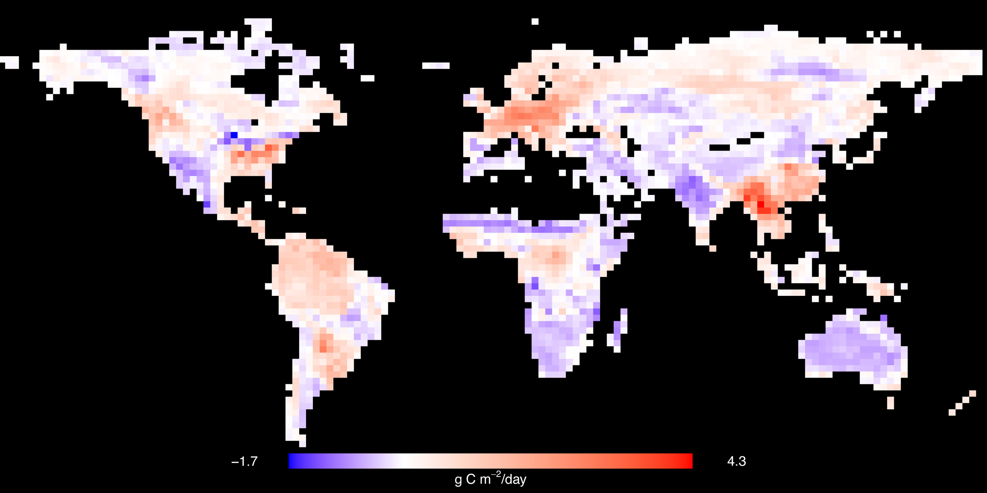

GLOBAL FLUX MAP, DIFFERENCE
GREEN: SINK
YELLOW: SOURCE
CMS
MPI-BGC
APR
NOV
MAR
JUN
OCT
JAN
SEP
AUG
MAY
DEC
JUL
FEB
BLUE: CMS IS BIGGER
WHITE: NO DIFFERENCE
RED: MPI-BGC IS BIGGER
MPI-BGC minus CMS

Slide 11






BIOME
APR
NOV
MAR
JUN
OCT
JAN
SEP
AUG
MAY
DEC
JUL
FEB

Slide 12


BEYOND ABSOLUTE NEE:
TIMING & AMPLITUDE OF MIN/MAX
NEE

Slide 13


TIMING OF MIN / MAX
BLUE: CMS TIMING IS LATE BY UP TO 6 MONTHS
WHITE: CMS TIMING IS THE SAME AS MPI-BGC
RED: CMS TIMING IS EARLY BY UP TO 6 MONTHS

Slide 14



AMPLITUDE

Slide 15
SUMMARY
The CMS flux product does a relatively good job in comparison with the upscaled eddy flux product in temperate regions and dry season tropics (including crops, grass, and savannas), and detection of the timing of greatest C uptake globally.
Improvement may be warranted over the boreal forests during the growing season, the wet season tropics, and detection of the timing of least C uptake.
Further analyses: GPP-only; 0-annual mean comparisons; climate space; MPI-BGC flags/uncertainty; benchmark-type summary statistics; incorporation of uncertainties in all CMS Flux components; back-calculation informing of CASA properties (e.g., fAPAR, R_{h}/GPP estimation).

Slide 16

IMPLICATIONS
For use in other scientific studies, inventories (by TRANSCOM region shown here)

Slide 17



IMPLICATIONS
Policy implications

Slide 18
quest ions | discussion

Slide 19
APPENDIX

Slide 20
MPI-BGC NEE UNCERTAINTY
<5% of sites: uncertainty > 200gC m⁻² yr⁻¹
>80% of sites: uncertainty <80 gC m⁻² yr⁻¹
NEE confidence range [gC m⁻² yr⁻¹]
Courtesy M. Reichstein
For NEE, analyses for interannual variability patterns are expected to be comparable, but some bias may be introduced with seasonal patterns, and even more with the mean flux.
Missing information: disturbance history, soil nutrients status, CO₂ fertilization.
Notes:
Make the point where the large uncertainties come from (not random, not gap-filling)

Slide 21
MPI-BGC UPSCALING
95%
Courtesy M. Reichstein
600
75%
Percentile of latitudinal band
from up-scaling
50%
25%
5%
Site
400
LSQ spline through sites
Mean Monthly GPP (g C m⁻² month⁻¹)
+
0.5° pixel around site
Flux sites are on “high end” of GPP (growing) relative to MPI-BGC pixel
LSQ spline through site pixels
200
0
-50
0
50
Latitude

